Slide 2
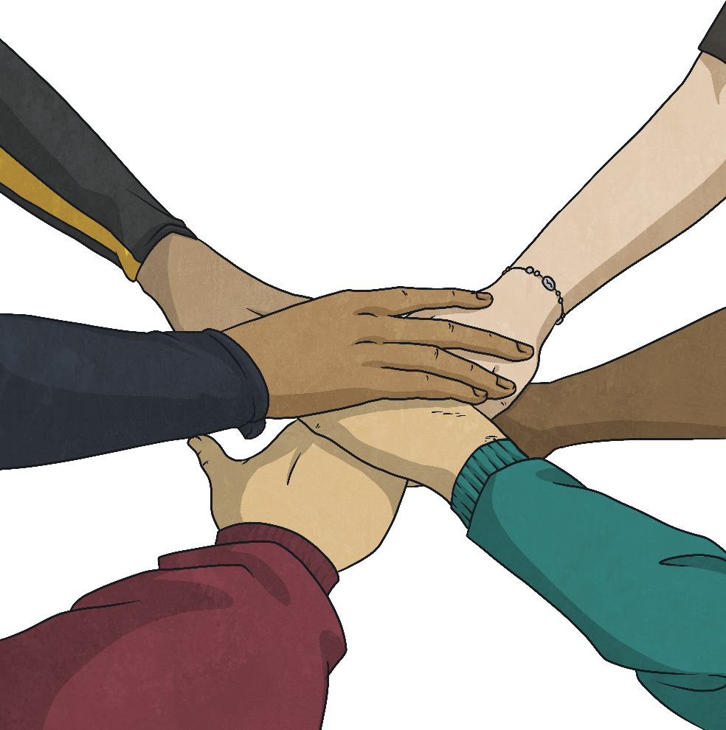
Helping
Hands

Slide 3
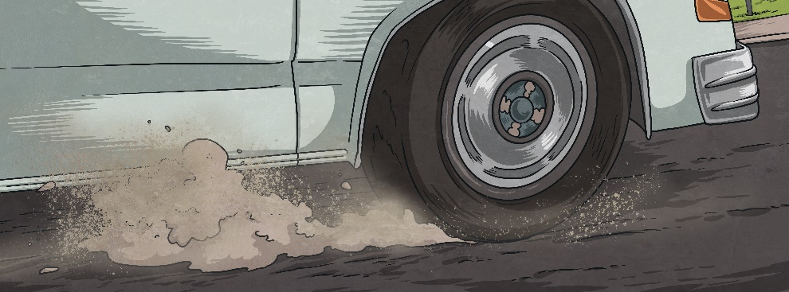
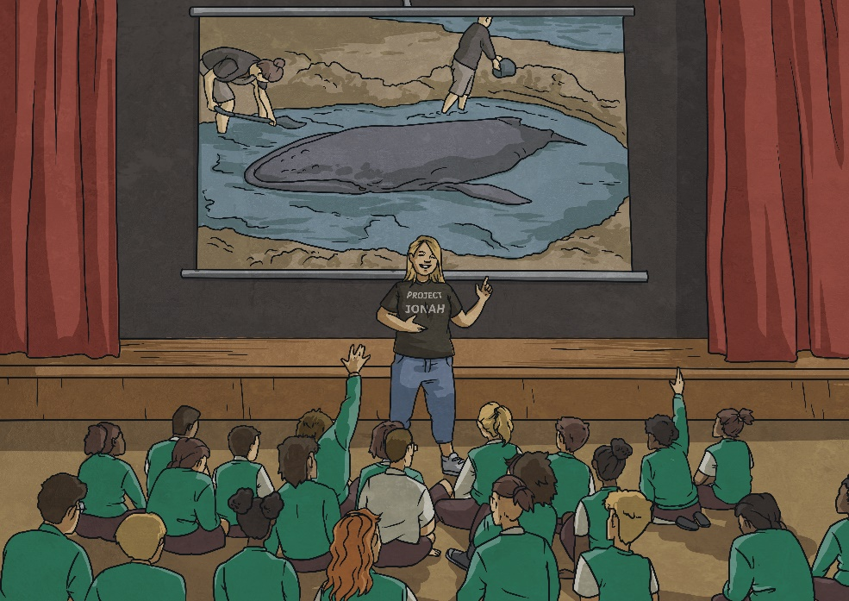
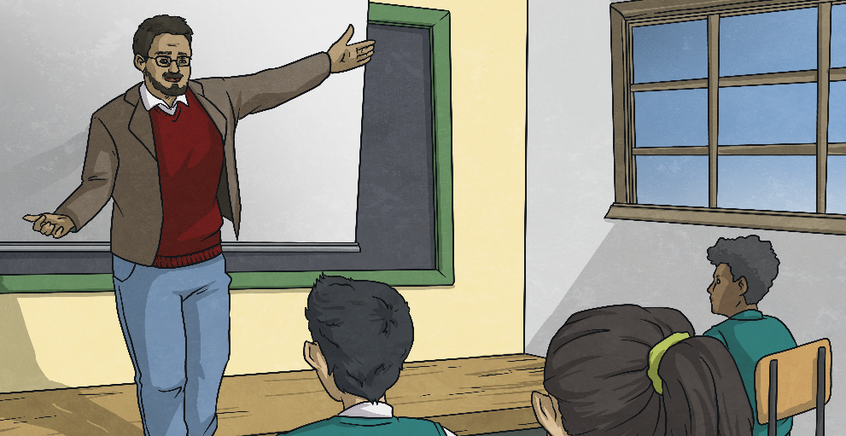
We rumbled along the coastline into town, but just before turning the corner toward school, I noticed a strange black boulder-like shape contrasting against the yellow sand. My mind instantly raced back to a couple of weeks ago when the Project Jonah team visited my school to teach us about whales and what to do when they strand.
Gravel crunched under the tyres as Dad turned our car out of the driveway. I still felt grumpy at my alarm for waking me up so rudely on the day I had been dreading all week. Public speaking was not something I enjoyed at all, so when Mr Grady announced that we would be doing our speeches today, my stomach sank like a brick. I breathed deeply and gazed out the window at the ocean, wishing that I could turn myself into a fish and swim away. Little did I know what was about
to unfold!
I was in awe when Louisa explained how whales migrate all across the oceans, and I remember wanting to do what I could to protect these amazing mammals. Could this be my chance?

Slide 4
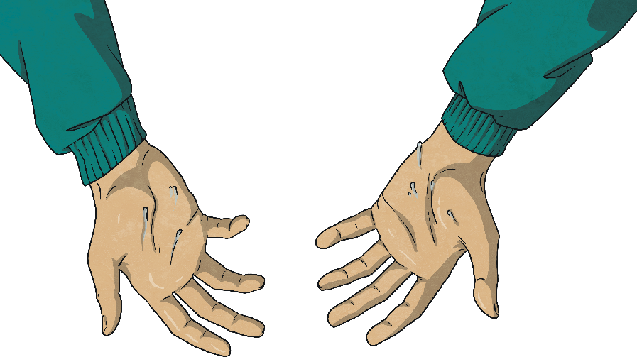
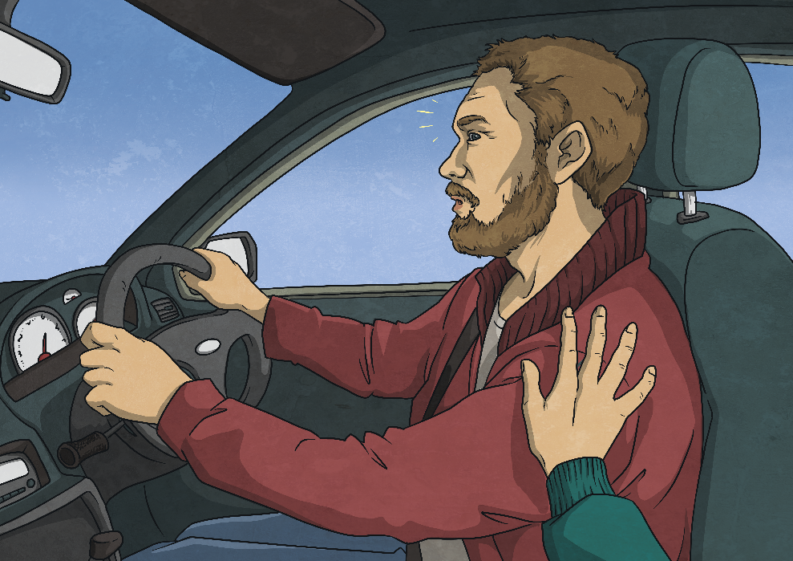
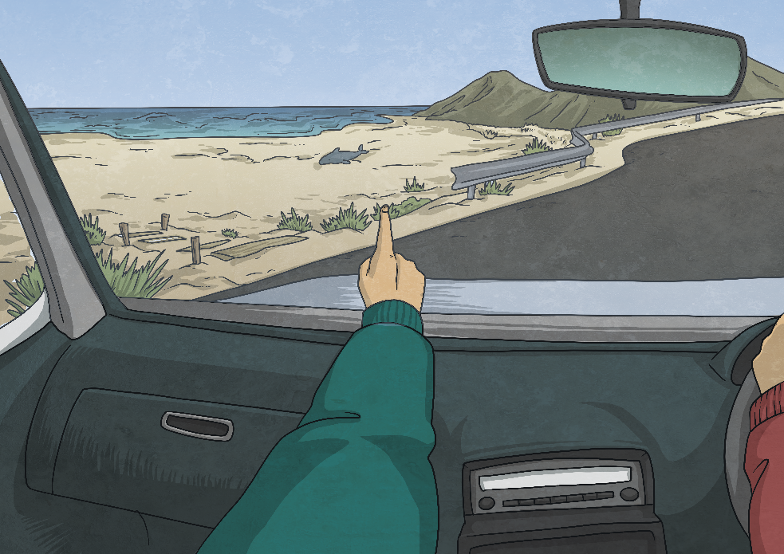
Dad looked at me with an amused expression. “I know you’ve been trying to get out of giving a speech all week, but trust me. You’re going to do an amazing job. You’ll feel so proud of yourself when it’s over.” He didn’t believe me!
My heart began to beat faster; even my palms were a little sweaty at the thought that this could be a whale that needed our help. “Dad, please stop the car! I think there’s a whale stranded on the beach!” I exclaimed, pointing toward the ocean.
“I know I’ve been saying how scared I am of today, but this is not a joke, Dad. I love whales - why would I make a joke? Please believe me,” I pleaded, “I’m telling the truth!” I urgently pointed out of the window. “Besides, even if I made a mistake and there isn’t a whale, we wouldn’t be late for school if we just turned around to check.”
“Alright, alright, let’s go and check quickly. If there’s no whale, then it’s straight back into the car with you and off to school quick smart!”

Slide 5
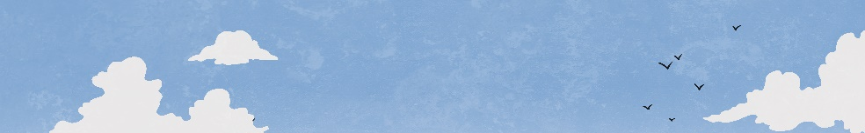

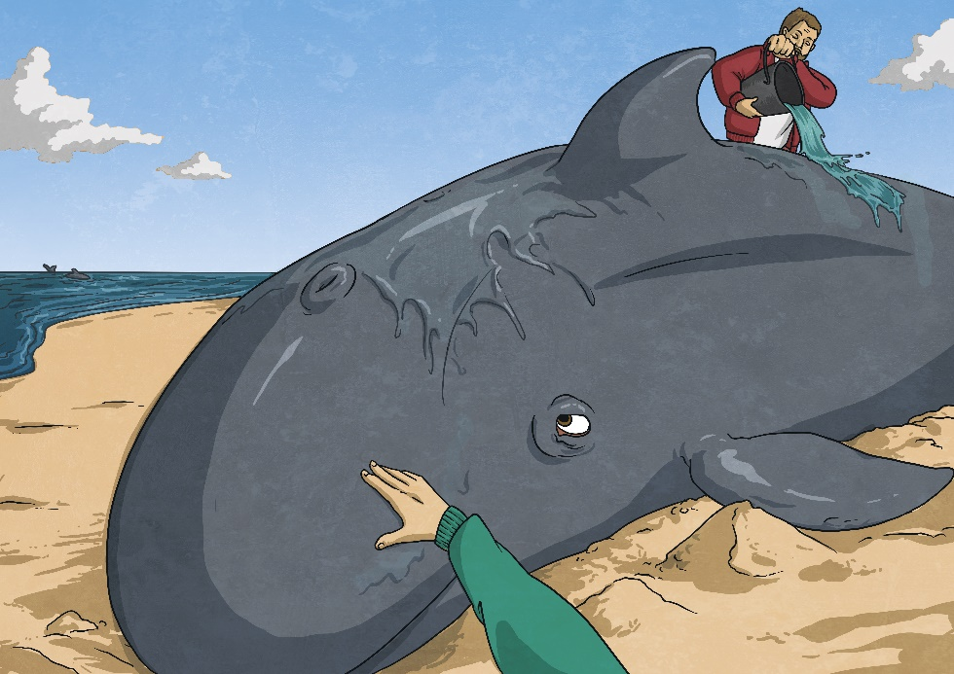
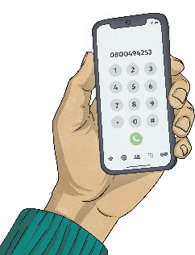
As soon as we pulled into the car park, I knew I hadn’t made a mistake after all. I leapt out of the car and ran to the fence post to get a better look. There, lying on the wet sand, was a small whale on its side making squealing noises. It looked like it was trying to swim but had no water around it. I could see its pod swimming back and forth just beyond the
breaking waves. I felt a bit shocked at first and tried hard to remember what Louisa had told us to do if we ever found a stranded whale.
While we waited for help to arrive, Dad and I walked slowly towards the whale, so we didn’t scare it. I thought back to the lesson on first aid for whales and told Dad that the first thing we had to do was keep the whale cool, especially on its flippers, fins and fluke, where the blood is closest to their skin.
We sang softly to the whale as we poured our bucket of water over it, making sure to keep away from its tail and in its line of sight. Sometimes I put my open hand on it gently to help comfort it.
“We need to call the hotline and get help,” I said
to Dad as he appeared beside me, carrying a
bucket he’d grabbed from the car. He quickly
pulled out his phone, and I recited the
New Zealand number to him. “It’s 0800
4 94253.” Dad dialled the number and
described what we were seeing.

Slide 6
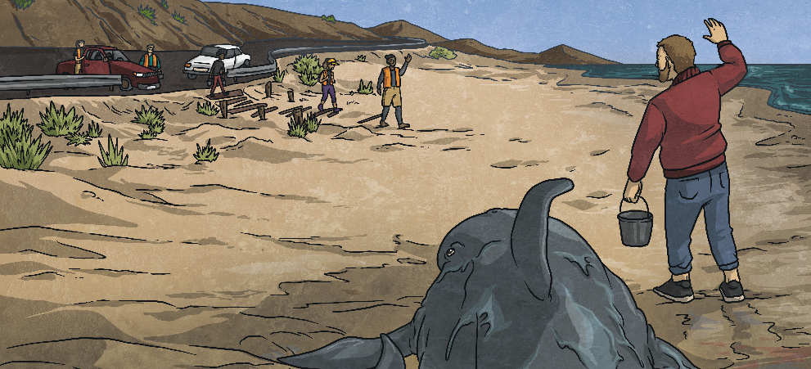
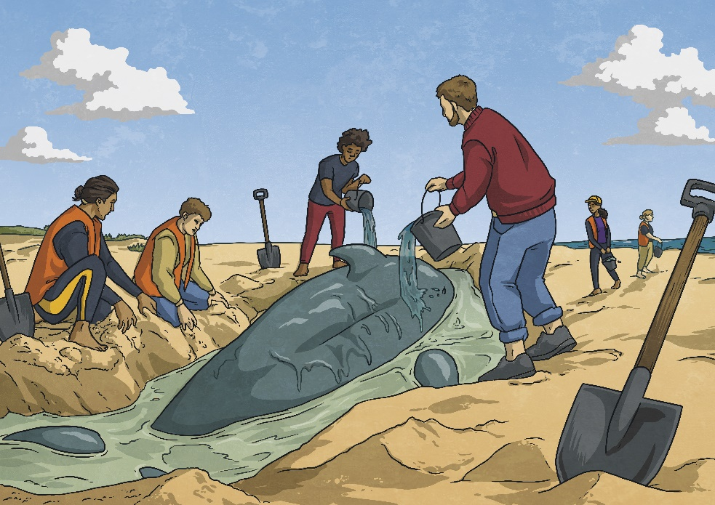
Some of the volunteers were carrying buckets of water back and forth. Others were digging the sand out from underneath its fins so they wouldn’t cramp or helping to roll it over onto its belly.
I recognised a few people from our local iwi coming down the beach towards us. “Mōrena!” They greeted us and asked about the whale’s condition before approaching it slowly, laying their hands on it and blessing it with a karakia. When other volunteers started to arrive, the iwi members had a conversation with some people who were from Project Jonah. There was another group wearing high visibility vests and carrying radios in their hands. Together, they were coming up with a plan about the best way to rescue the whale.
The conversations ended, and they turned to the rest of us volunteers to give us jobs to do. They told us that it was a false killer whale, still a calf, and it probably got separated from its pod when it went looking for food on its own. “It’s really important that it is returned to its pod as soon as possible because calves can’t survive on their own,” explained
Anaru. He seemed to be the person in charge. “We can only do this if we work together, but remember that your safety is most important,” he reminded us.
I remember Louisa telling my class that when whales are lying on their sides, they can easily injure the flipper they’re laying on, and they need these to steer through the water.
By 11 o'clock, the sun was beating down on us from the blue sky.

Slide 7
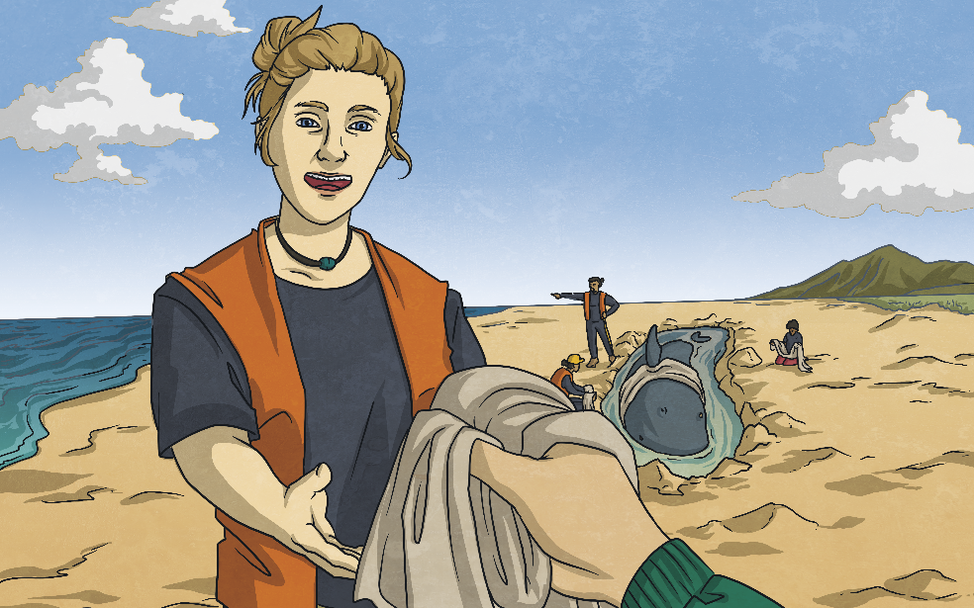
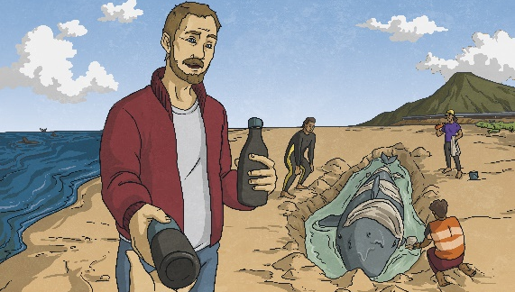
The day wore on. I was feeling quite tired and a little bit sad. It felt like we had been here forever, and the whale was still stuck on the shore. Its family had been coming and going all day, and sometimes, when they called, it would make squeaking noises back. Every time the whale made a noise or slapped its tail, I could feel my stomach tighten. I felt overwhelmed at how beautiful it was up close, excited that I got to be part of this but also a little bit scared because I really wanted it to get back to its family.
Eleanor, a Project Jonah volunteer, asked me if I could help her put a wet, light-coloured sheet on the whale’s skin to keep it cool and stop it from getting sunburnt.
“How are you doing, Hannah?” Dad asked, putting his hand on my shoulder. “Ready for a break?” I didn’t want to stop helping, but the sun was making me thirsty and I knew I needed to put more sunscreen on. “Just a short one,” I replied, “and then I want to keep helping. Do you think it’s going to be okay?” I looked up at Dad for a sign that things were getting better. He smiled down at me and explained that the people in charge were doing a great job showing us what to do and that everyone was giving their best.
I felt excited that she asked me because it made me feel like I was doing something important to help. “Here you go,” Eleanor smiled as she handed me the wet sheet. “So you’re going to drape it over its back, around its dorsal fin. Just like this!” I carefully watched the way she did it and then stood on my tiptoes to gently place my side of the sheet around the small fin on its back.

Slide 8
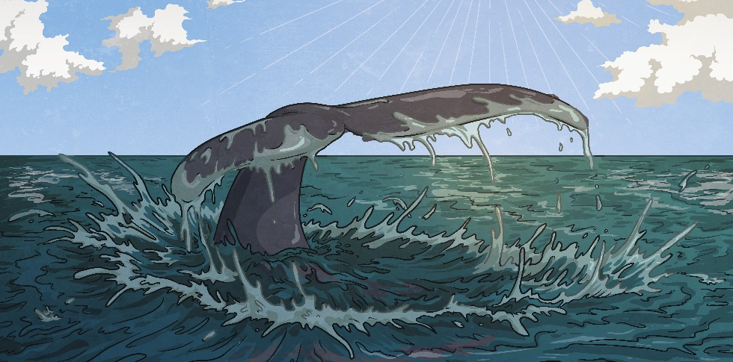
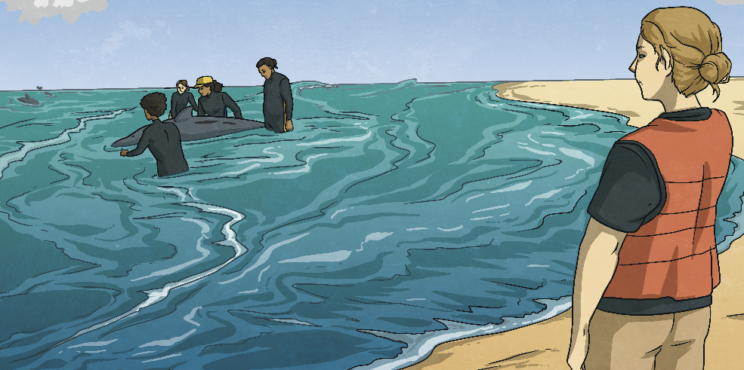
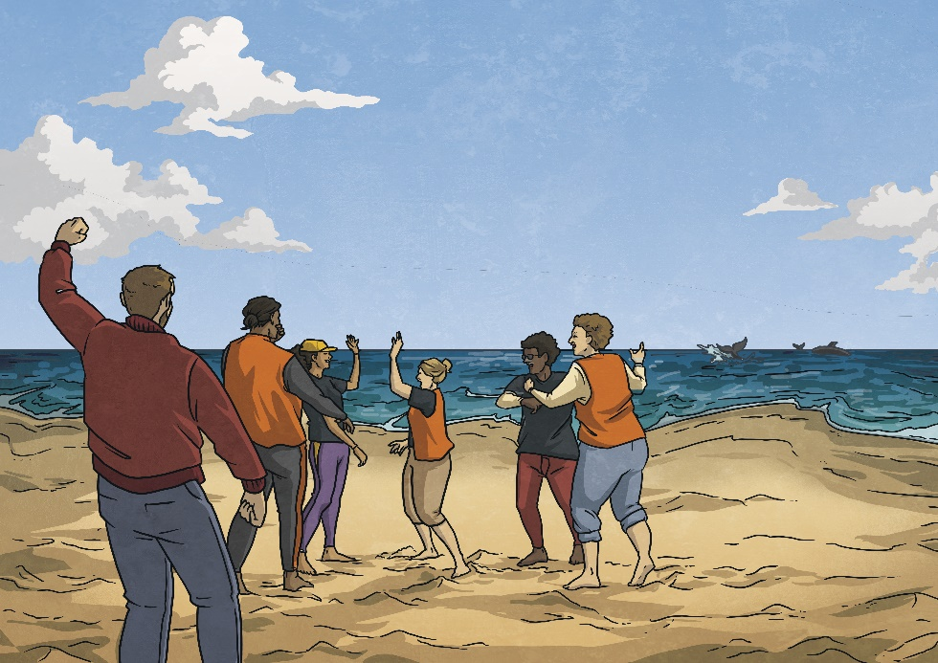
After having a rest, a drink and a snack, I noticed that the water had moved closer to me. The tide was coming in! I ran back down toward the whale so I could hear what Anaru was saying. He explained that because the water around the whale
would get deeper, the kids needed to move up the beach closer to the dunes. The adults would hold the whale steady until there was enough water around it to float and then gently rock it from side to side so it could get its balance back. I thought back to the school visit and remembered that this step was called ‘reorientation’.
With a splash, it gave some hard slaps of its tail, dipping below the waves while the local iwi stepped forward and said, “E hoki ki a Tangaroa ara rau, Tangaroa pū-kanohi nui, hoki atu rā, hoki atu rā.”
We all cheered so loudly when we saw the calf swimming back with its family in the distance. I felt exhausted and ready for bed but also extremely happy that it was back where it belonged.
After some time, the whale was floating and seemed to have its balance back. The water was now high enough for Anaru and some Project Jonah volunteers to turn the whale around and face it out toward the ocean.

Slide 9
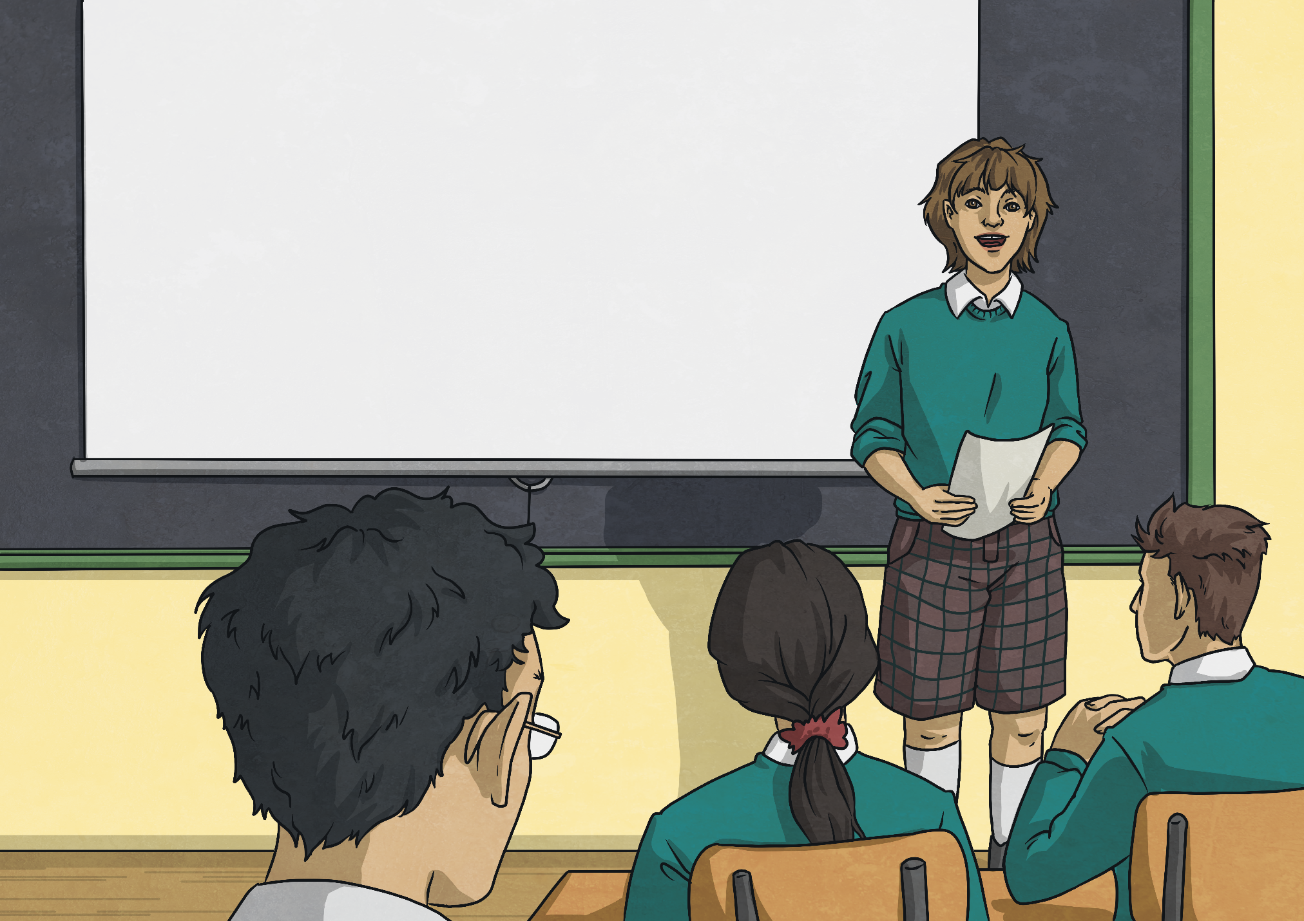
“Thank you for listening to my speech – I hope you enjoyed it and learned something interesting today.” I let out a big sigh as I sat back down with my
classmates and smiled to myself. That wasn’t so bad after all.

