Slide 1
Disclaimer/s
We hope you find the information on our website and resources useful.
Animations
This resource has been designed with animations to make it as fun and engaging as possible. To view the content in the correct formatting, please view the PowerPoint in ‘slide show mode’. This takes you from desktop to presentation mode. If you view the slides out of ‘slide show mode’, you may find that some of the text and images overlap each other and/or are difficult to read.
To enter slide show mode, go to the slide show menu tab and select either from beginning or from current slide.
You may wish to delete this slide before beginning the presentation.

Slide 3
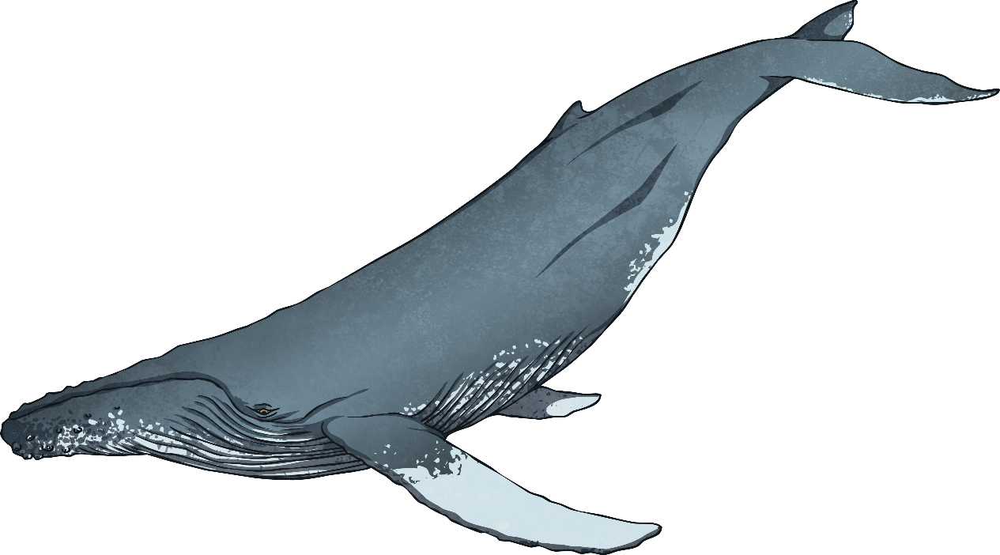
Marine Mammals in New Zealand
Whales, dolphins and seals are all marine mammals that can be found around New Zealand.
Learn about the different types of marine mammals and where they can be found by clicking on the map of New Zealand on each slide.
Mammals are warm-blooded animals that breathe air and give birth to live young - just like humans!
Te Reo Māori
Mammal - Whāngote

Slide 4
Hector's Dolphin
Hector’s dolphins are the smallest species of dolphin in the world. They are grey with black and white markings and a rounded black dorsal fin.
Hector’s dolphins use echolocation to find fish, squid and crustaceans to eat.
They like to live in pods of between two and eight dolphins.
Hector’s dolphins like to remain close to shore where they are safer from predators and have a ready supply of their preferred food.
Hector’s dolphins are only found in the waters around the South Island, especially in the Marlborough Sounds, the West Coast and Kaikōura.
Echolocation
Where dolphins hunt food by making a high-pitched sound that bounces off their prey so the dolphin can find them.

Slide 5
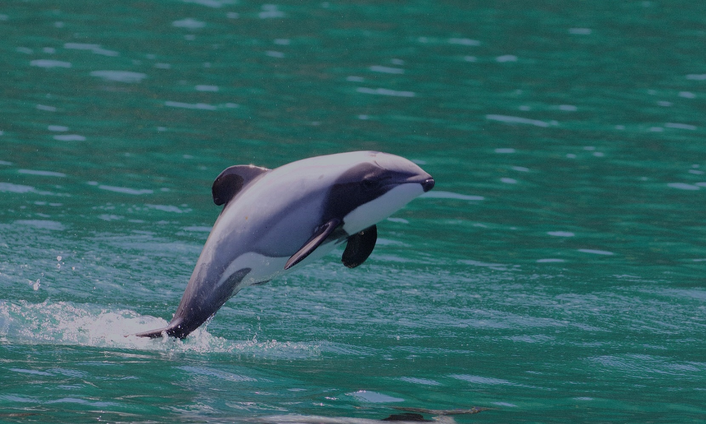
Hector's Dolphin
There are three names for the different types of Hector’s dolphin in te reo Māori. Tutumairekurai, Pehipehi, Ahoaho.
“Hector's Dolphin (Cephalorhynchus hectori)” by [Gregory Smith] is licensed under CC BY 2.0

Slide 6
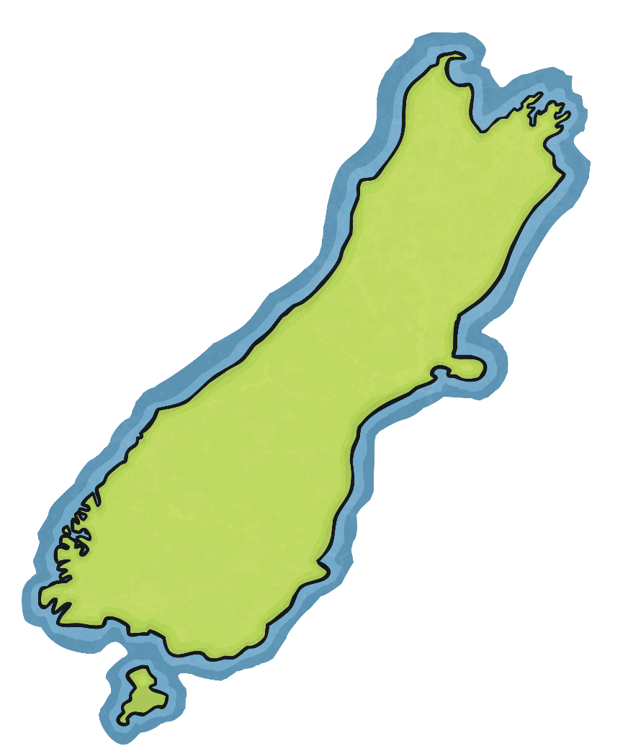
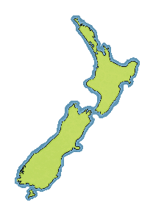
Hector's Dolphin
Marlborough Sounds
Te Aumiti
West Coast
Te Tai Hauāuru
Kaikōura
South Island
Te Waipounamu

Slide 7
Māui’s Dolphin
Māui’s dolphins are a subspecies of Hector’s dolphins.
They look very similar to Hector’s dolphin but have a larger skull and longer, wider snout.
Māui’s dolphins tend to live in small pods of up to around five dolphins.
Like Hector’s dolphins, Māui’s dolphins live close to shore to keep them safe from predators and use echolocation to find fish, squid and crustaceans to eat.
Both the Hector’s and Māui’s dolphins are endangered.
Māui’s dolphins are found in the coastal waters of the north-west of the North Island in the areas from Maunganui Bluff to Whanganui.
Te Reo Māori
Māui’s Dolphin - Tūpoupou

Slide 8
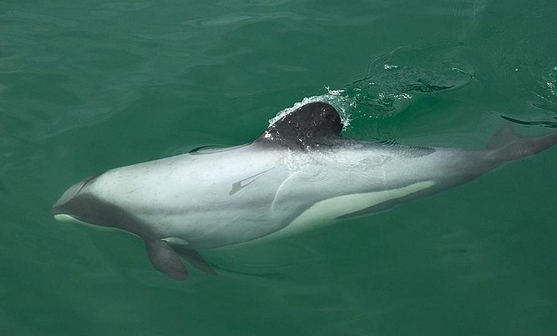
Māui’s Dolphin
Maui’s dolphins look very similar to Hector’s dolphins!
“Maui's dolphin” by [vivtony00] is licensed under CC BY 2.0

Slide 9
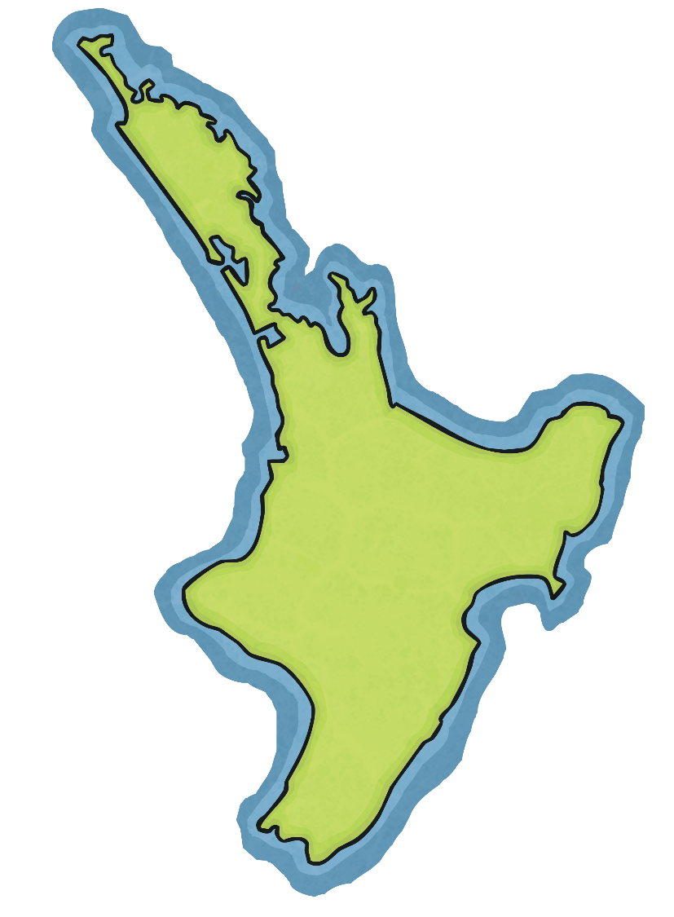
Māui’s Dolphin
Maunganui Bluff
Whanganui
North Island
Te Ika a Māui

Slide 10
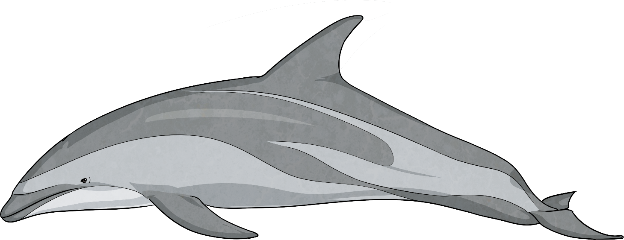
Dusky Dolphin
Dusky dolphins like to live in large pods, which may contain up to 1000 animals!
They feed on small fish and squid.
Dusky dolphins are well known for their acrobatics and often jump, dive and play in the sea.
Dusky dolphins have a white underside, with a bluish-black body and tail. They have very short beaks and a blunt dorsal fin.
Dusky dolphins are coastal and prefer water less than 2000m deep. They live in the waters of the Southern Hemisphere and can be found in New Zealand down the East Coast, south of the East Cape. They are commonly seen in Kaikōura and the Marlborough Sounds.
Te Reo Māori
Dusky Dolphin - Aihe Kaunehunehu

Slide 11
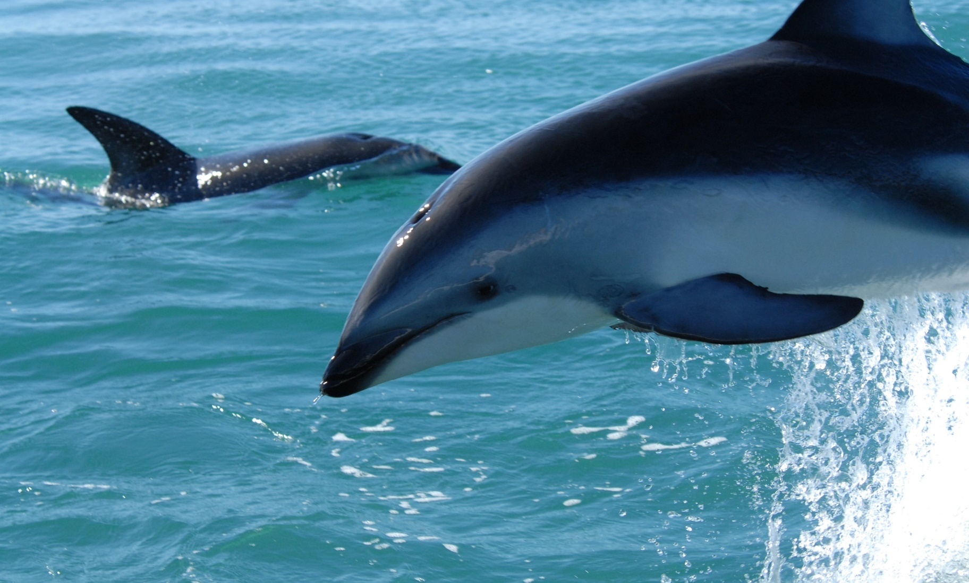
Dusky Dolphin
“anim1801” by [NOAA Photo Library] is licensed under CC BY 2.0

Slide 12
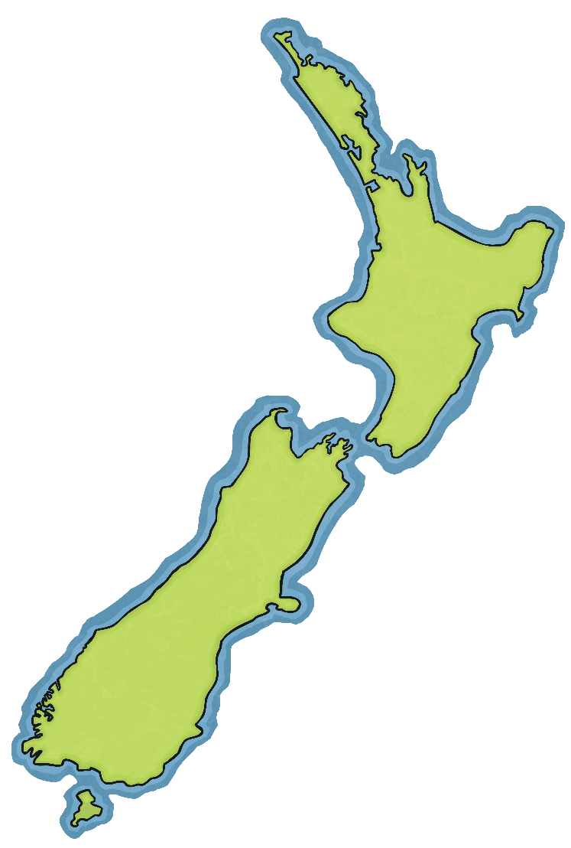
Dusky Dolphin
East Cape
Te Tai Rāwhiti
Marlborough Sounds
Te Aumiti
Kaikōura
East Coast
Te Tai Rāwhiti

Slide 13
Common Dolphin
Common dolphins have a striking white or plain pattern on their flanks. Their dorsal fin is high and curved.
They can form pods containing thousands of dolphins and are sometimes found alongside groups of pilot whales and dusky dolphins. Common dolphins hunt cooperatively, feeding on a variety of surface and mid-water fish and squid.
Common dolphins like to remain close to shore and are found year-round in the Hauraki Gulf and commonly around Northland. They can also be seen around other areas of New Zealand.
Te Reo Māori
Common Dolphin - Aihe

Slide 14
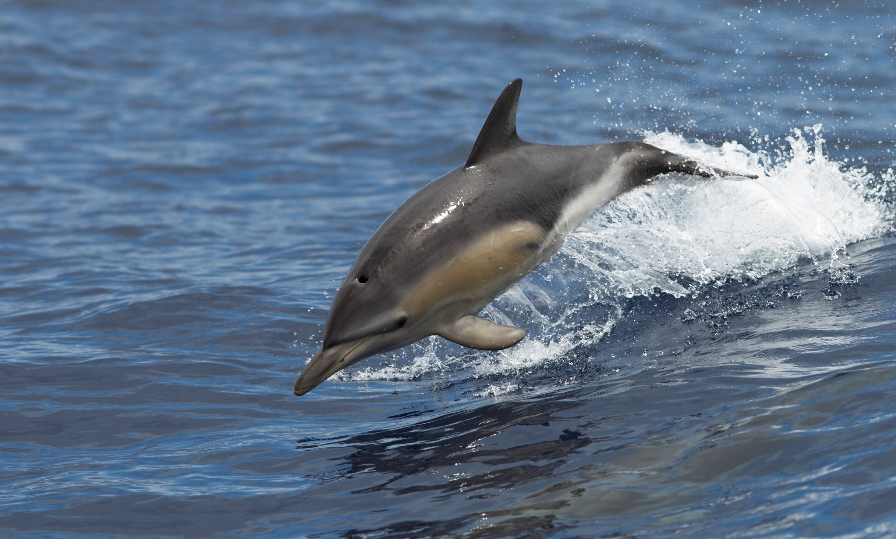
Common Dolphin
“Common Dolphin” by [Ed Dunens] is licensed under CC BY 2.0

Slide 15
Common Dolphin
Hauraki Gulf
Te Pare o Hauraki
North Island
Te Ika a Māui

Slide 16
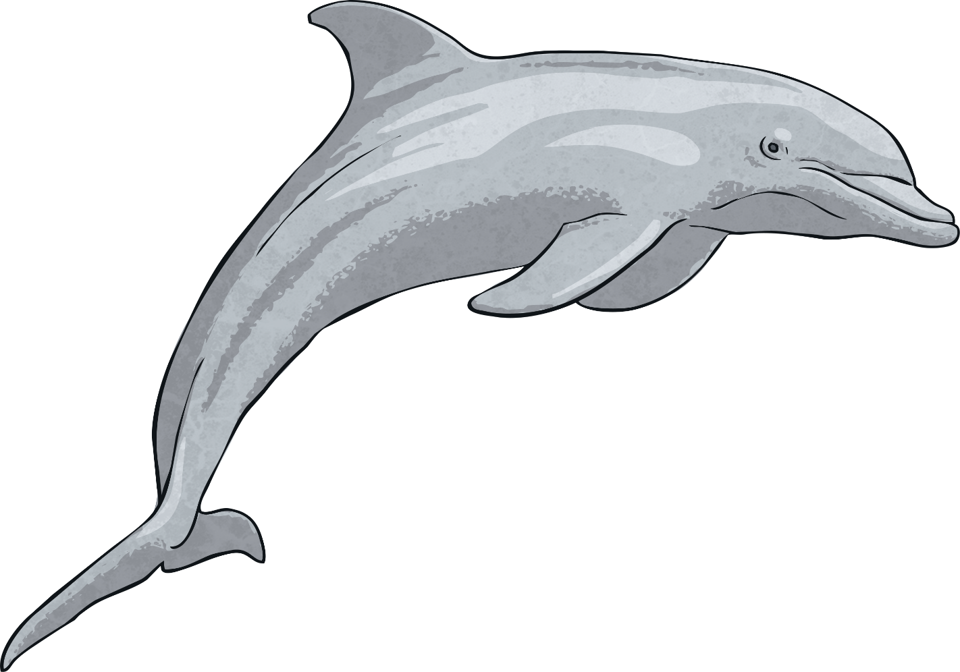
Bottlenose Dolphin
Bottlenose dolphins are mostly grey and have a paler colour underneath.
Their dorsal fin has a strong curved shape.
Bottlenose dolphins that live close to shore like to live in pods of up to 15 dolphins.
Bottlenose dolphins that live offshore can live in pods of up to 20 dolphins. They feed on squid and fish.
Bottlenose dolphins live in oceans around the world. In New Zealand, they are found on the East Coast of the upper North Island, around Fiordland and the Marlborough Sounds.
Te Reo Māori
Bottlenose Dolphin - Terehu

Slide 17
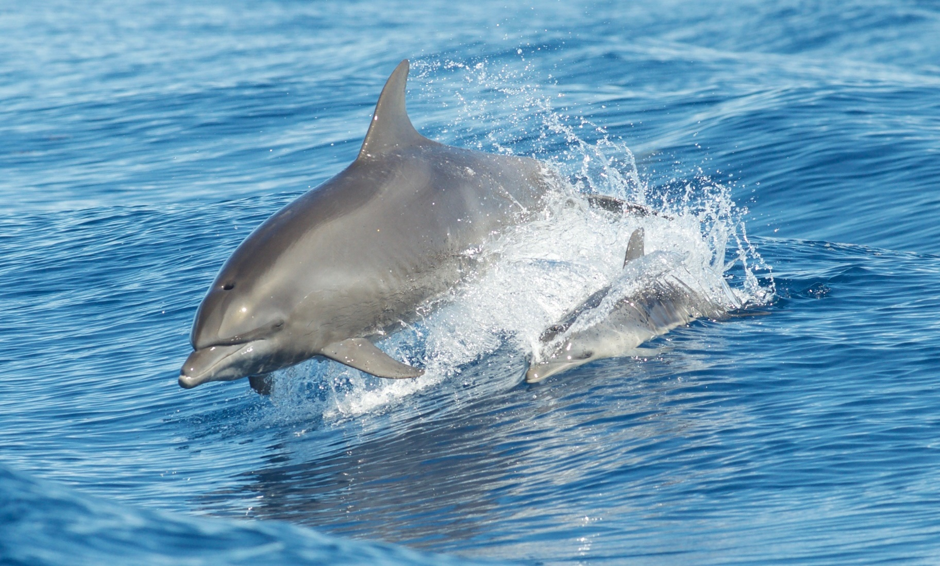
Bottlenose Dolphin
“Atlantic Bottlenose Dolphins” by [Brandon Trentler] is licensed under CC BY 2.0

Slide 18
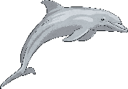
Bottlenose Dolphin
East Coast
Te Tai Rāwhiti
Marlborough Sounds
Te Aumiti
Fiordland
Te Whakataka-kārehu-a-Tamatea

Slide 19
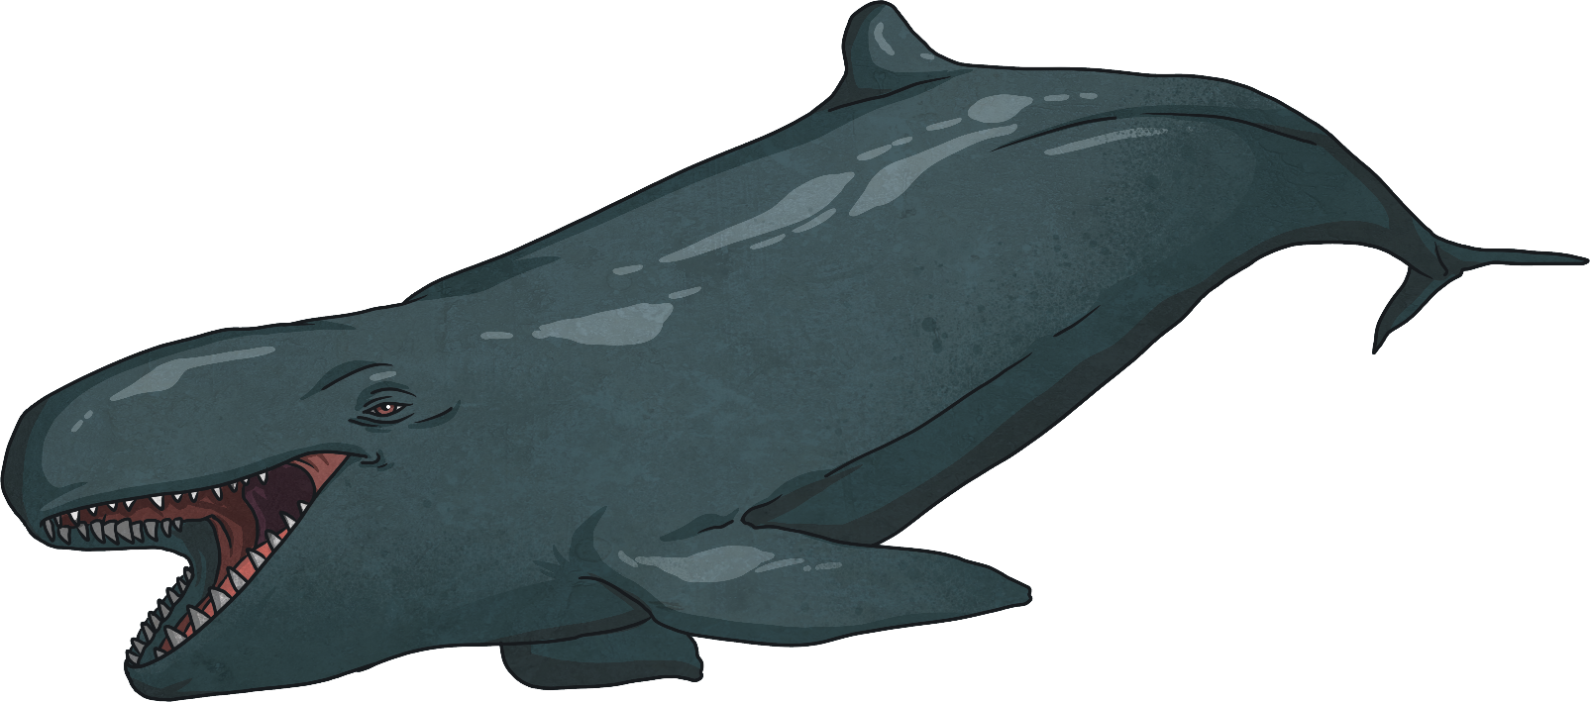
False Killer Whale
False killer whales are not a whale but a member of the dolphin family.
They have a long and slender body and a small dorsal fin, just like a dolphin. Their head is a similar shape to that of the orca (killer whale).
They look very similar to, and can sometimes be mistaken for, pilot whales.
False killer whales are most commonly sighted along the north-east coast of the upper North Island.
Te Reo Māori
False Killer Whale - Maki Kēhua

Slide 20
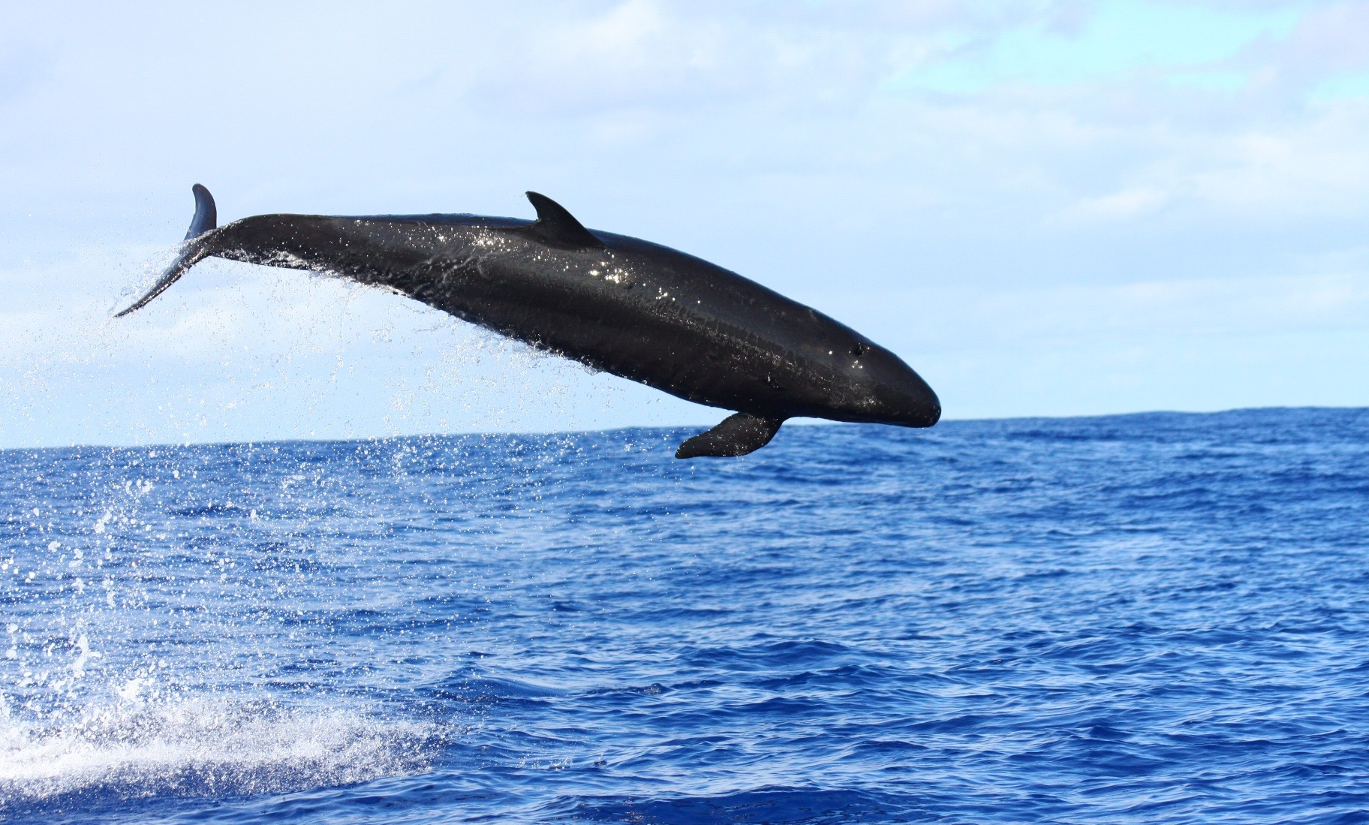
False Killer Whale
“anim2620” by [NOAA Photo Library] is licensed under CC BY 2.0

Slide 21
False Killer Whale
East Coast
Te Tai Rāwhiti
North Island
Te Ika a Māui

Slide 22
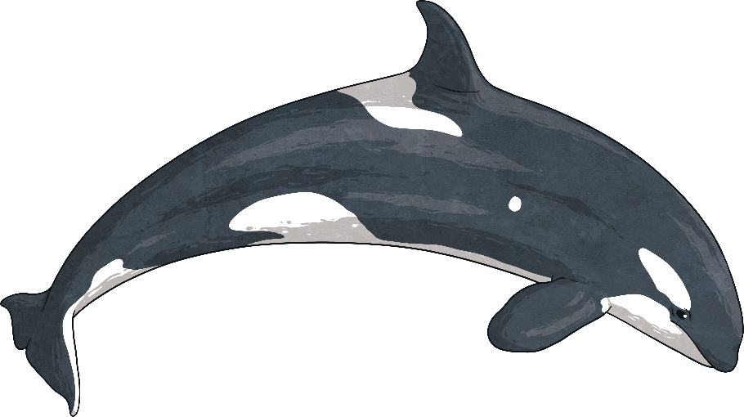
Orca (Killer Whale)
Even though orca are also known as killer whales, they are the largest of the dolphin species.
Orca have a black upper body with white underneath. They have a black, round-shaped head and a white patch behind each eye.
Orca like to live in social pods, sometimes containing up to 25 whales.
Orca like to feed on fish and squid but will also hunt larger marine mammals. New Zealand orca also prey on stingray and are the only orca in the world who know how to do this.
Orca are found along all of New Zealand’s coastline.
Te Reo Māori
Orca – Maki
Coastline - Takutai

Slide 23
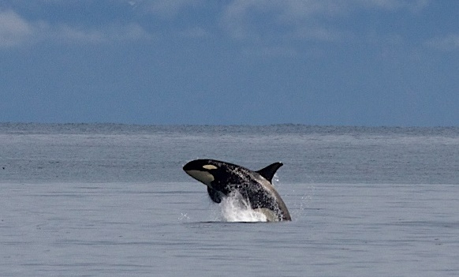
Orca (Killer Whale)

Slide 24
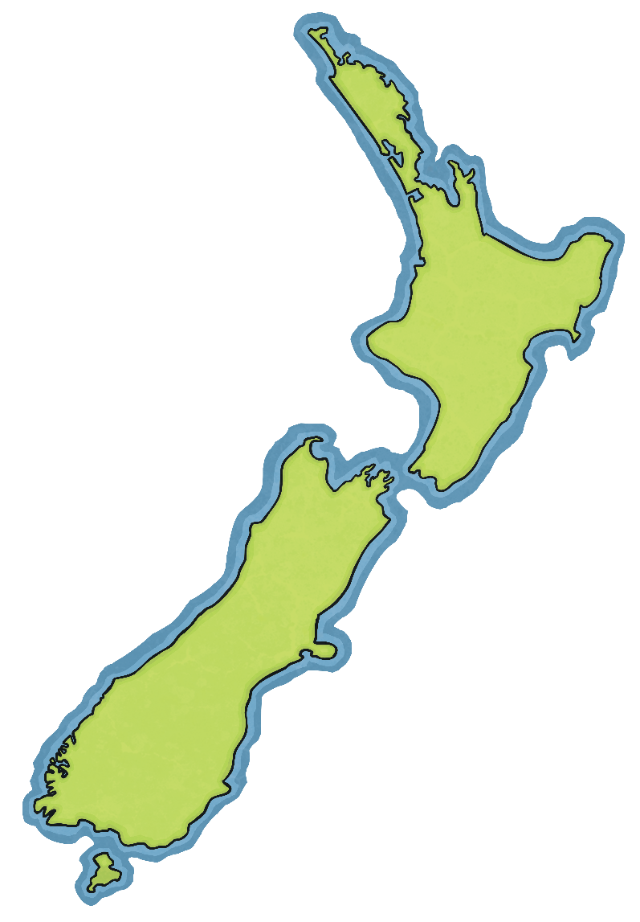
Orca (Killer Whale)

Slide 25
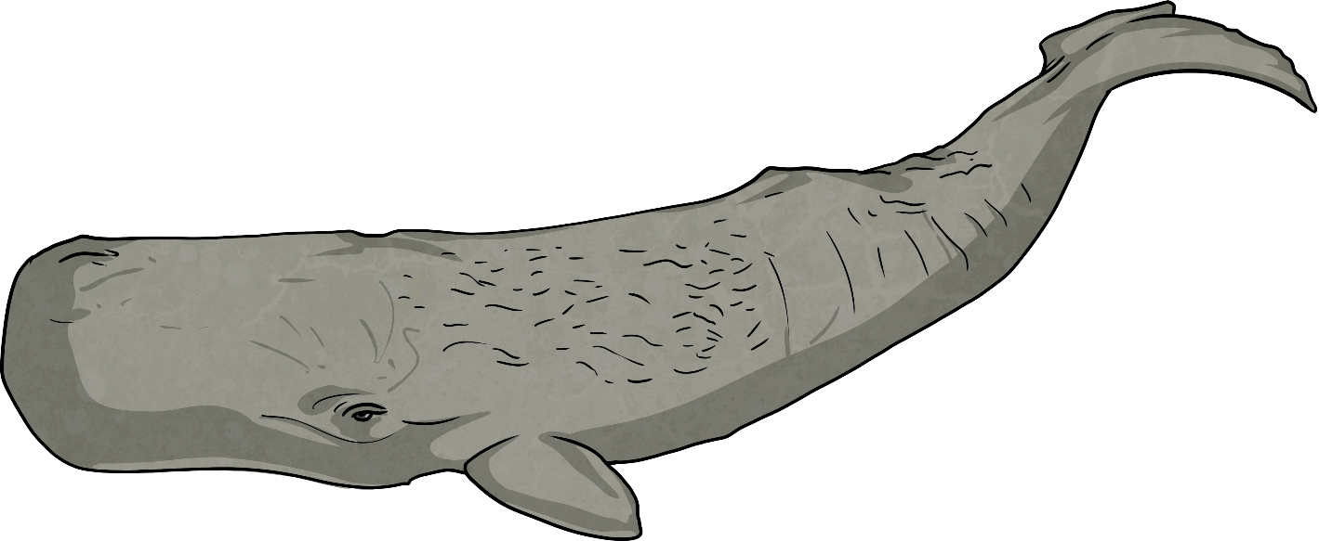
Sperm Whale
Sperm whales are a dark grey colour. Their large head is a blunt round shape and takes up one-third of their body length. The skin on the other two-thirds of the body is wrinkly.
Sperm whales can be as long as 18m.
Sperm whales like living in deep water. The males come closer to shore than the females and calves do.
They have teeth rather than baleen and feed mainly on squid.
Sperm whales are found in the submarine canyon near Kaikōura.

Slide 26
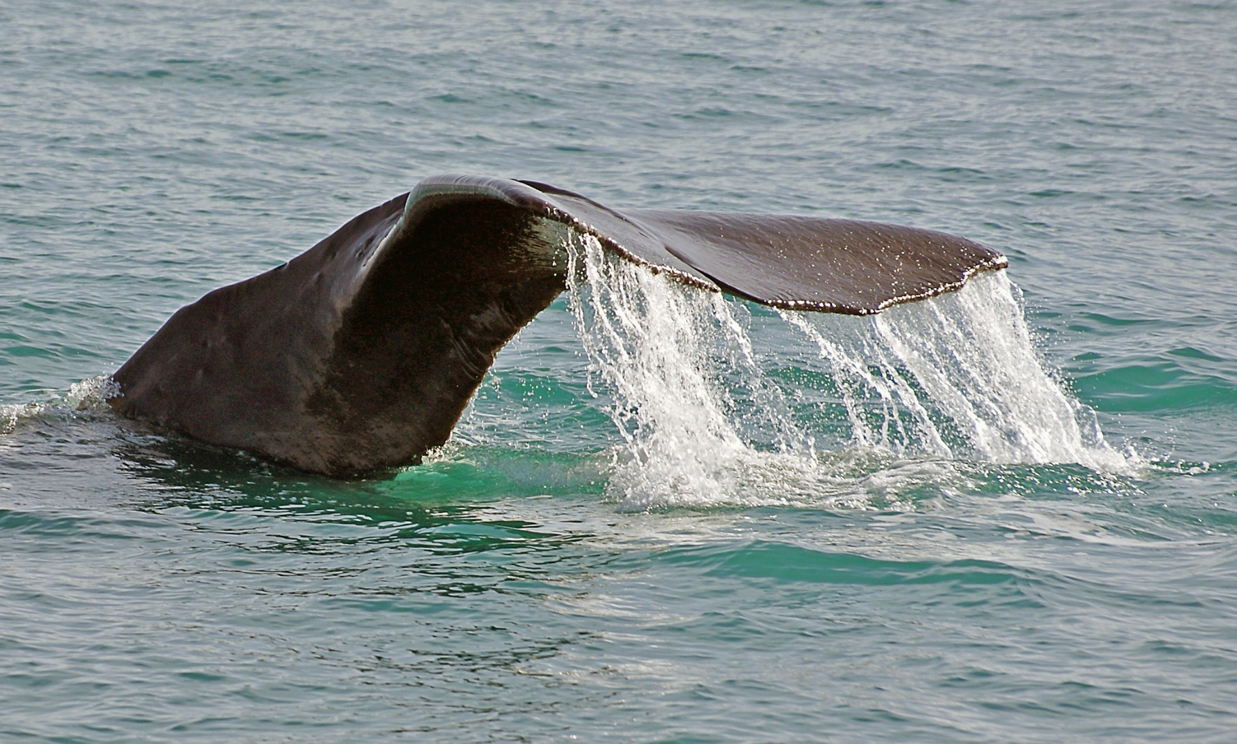
Sperm Whale

Slide 27
Sperm Whale
Kaikōura
South Island
Te Waipounamu

Slide 28
Humpback Whale
Humpbacks are most identifiable by their large pectoral fins. They generally have a black body with white underneath. Humpback whales have large tail flukes that have a unique black and white pattern.
They have a small dorsal fin and tend to have knobbly growths around their head. They are most easily identifiable because of their pectoral fins, which can grow up to 3m long.
A humpback whale’s diet consists of krill and small fish, such as herring.
Humpback whales migrate past New Zealand. They mainly travel along the South Island's east coast and through the Cook Strait in the winter. During spring, they travel along the west coast.
Migration
When whales move from one location to another as the seasons change.
Te Reo Māori
Humpback Whale - Parāoa
South Island - Te Waipounamu
Cook Strait - Raukawa Moana

Slide 29
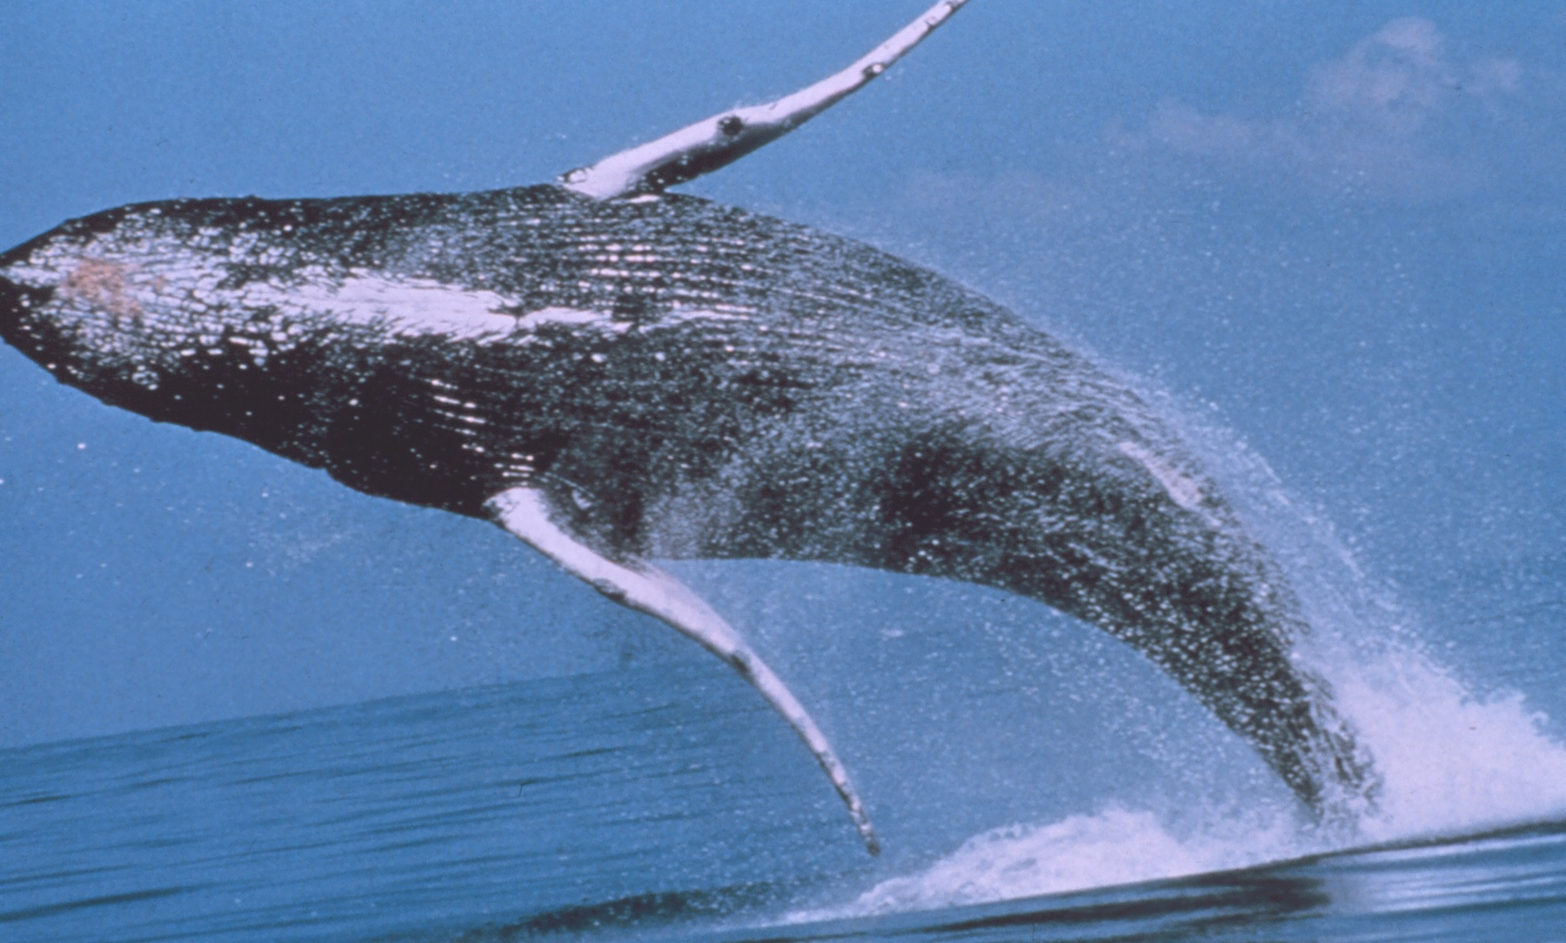
Humpback Whale

Slide 30
Humpback Whale
Cook Strait
Raukawa Moana
South Island
Te Waipounamu

Slide 31
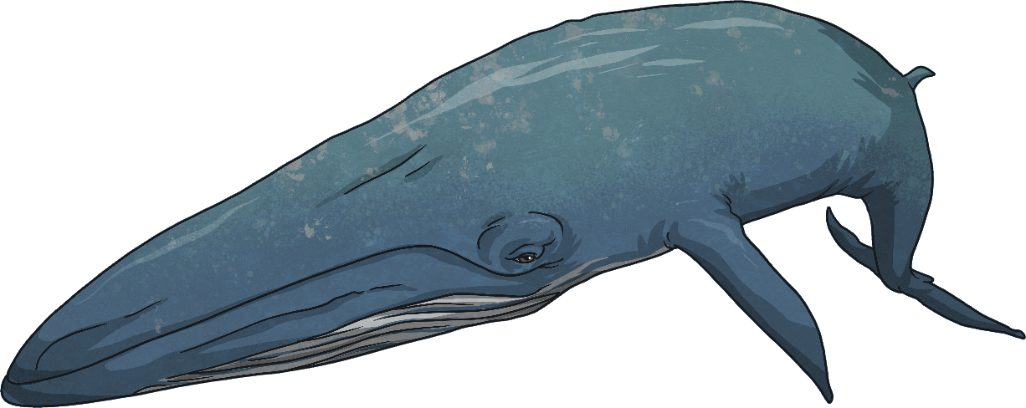
Bryde’s Whale (Pronounced: Broo-dus)
Bryde’s whales have long smokey grey bodies with white or pale yellow markings underneath.
Their dorsal fin is three-quarters along their body and has a prominent arch.
Bryde’s whales live in small pods of up to seven whales, but some pods may gather together if there are good feeding grounds.
They feed on schools of fish and krill.
The Bryde’s whale is endangered in New Zealand.
Bryde’s whales are found year round in the Hauraki Gulf, near Auckland.
Te Reo Māori
Hauraki Gulf - Te Pare o Hauraki

Slide 32
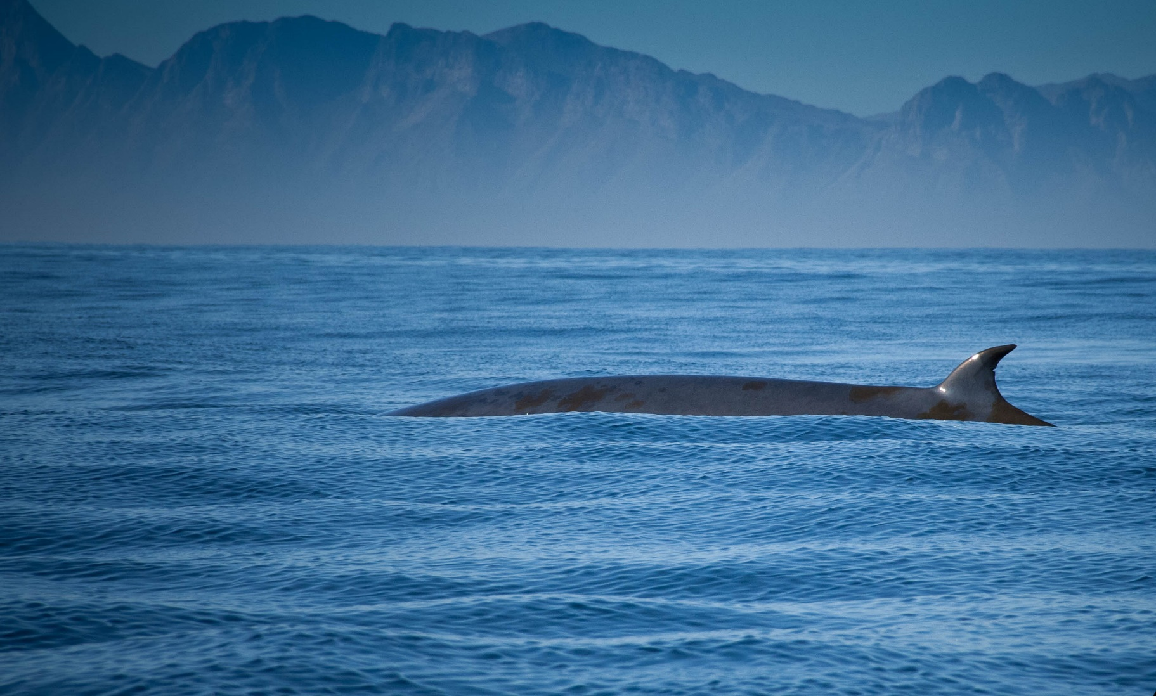
Bryde’s Whale
“Brydes whale” by [Jolene Thompson] is licensed under CC BY 2.0

Slide 33
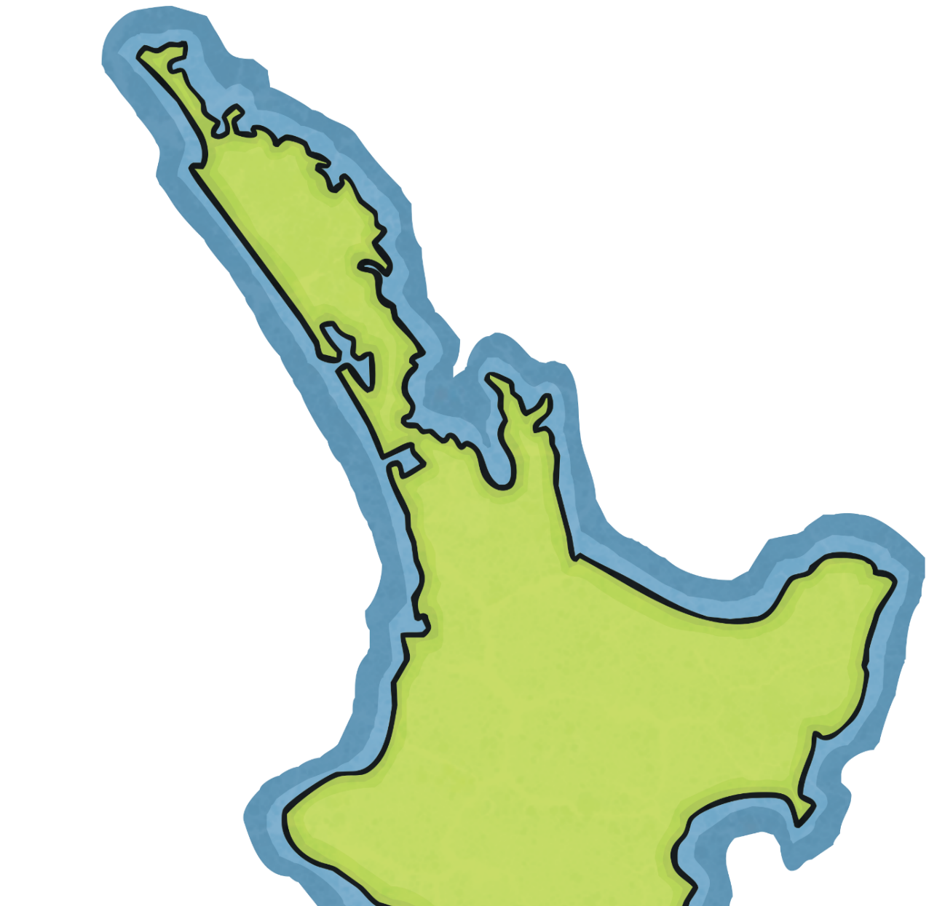
Bryde’s Whale
Hauraki Gulf
Te Pare o Hauraki
North Island
Te Ika a Māui

Slide 34
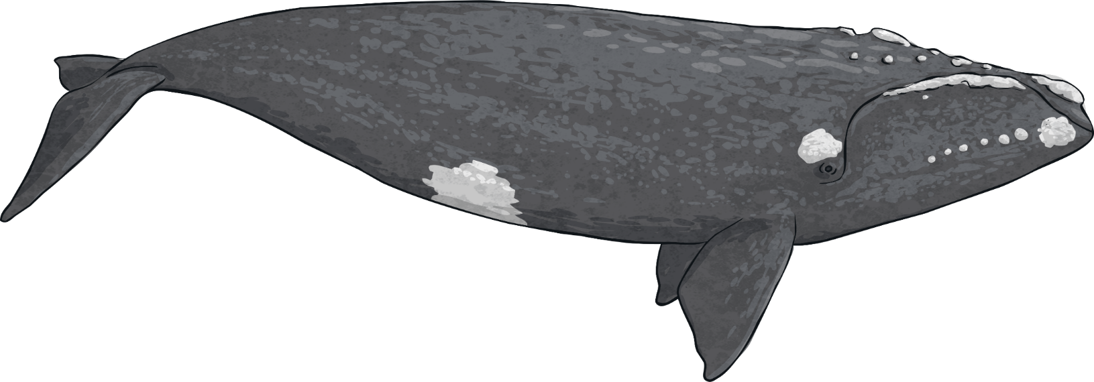
Southern Right Whale
Southern right whales’ bodies are a black or dark brown colour. They sometimes have pale regions on the underside and bumps on their bodies, and they don’t have a dorsal fin.
Southern right whales tend to be solitary or live in small groups. They sometimes come together in larger groups if there are rich feeding grounds.
Their main food is krill, plankton, small crustaceans and other tiny sea dwellers. They can come quite close to shore as they look for food.
Southern right whales are migratory, and can sometimes be seen from New Zealand beaches.
Te Reo Māori
Southern Right Whale - Tohorā

Slide 35
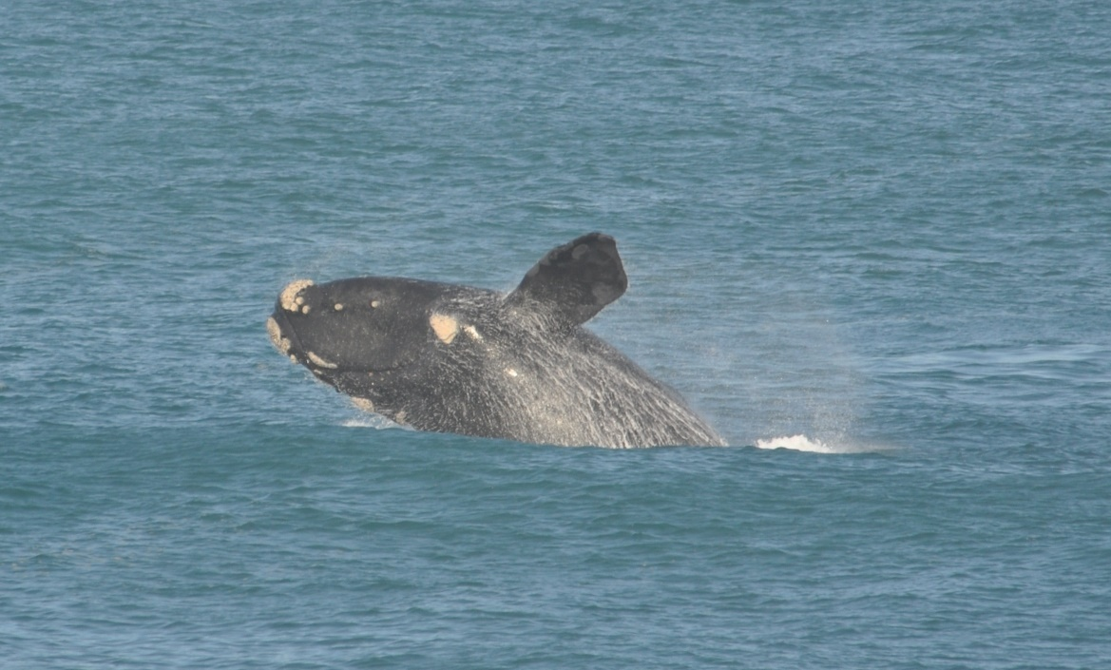
Southern Right Whale
“Southern Right Whale at Logans beach, Victoria” by [Department of Environment & Primary Industries] is licensed under CC BY 2.0

Slide 36
Southern Right Whale

Slide 37
Blue Whale
Blue whales are the largest animal in the world. They have a dark blue-grey colour with some paler colours underneath. Their dorsal fin is small and set further along their body.
Blue whales usually live alone or in pairs but form larger groups when in good feeding grounds.
Blue whales are found offshore from the Bay of Islands and Kaikōura. They have recently been discovered feeding in the South Taranaki Bight.
Te Reo Māori
Blue Whale - Wēra Kahurangi
Bay of Islands - Pēwhairangi

Slide 38
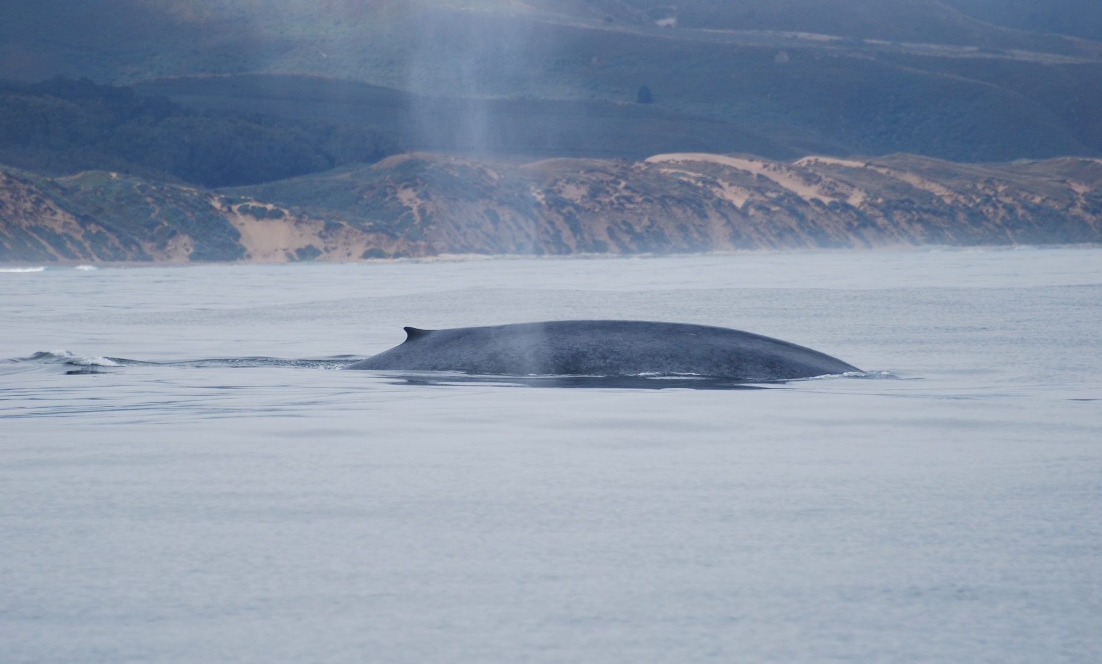
Blue Whale
“Blue Whale (Balaenoptera musculus)” by [David Slater] is licensed under CC BY 2.0

Slide 39
Blue Whale
Bay of Islands
Pēwhairangi
South Taranaki Bight
Kaikōura

