Slide 2
So What Do You Already Know About Whales?
Have a whole group or buddy discussion. You might want to write all your ideas down on a large piece of paper or whiteboard.
Here are some extra questions to help get your discussions going…
What different species of whales are there?
How big are whales?
What do whales eat?
Whereabouts in the world do they live?
Has anyone been whale watching?
What do you know about the whaling trade and its link to NZ’s early history?
Do you know anything about the “Save the Whales” movement?

Slide 3
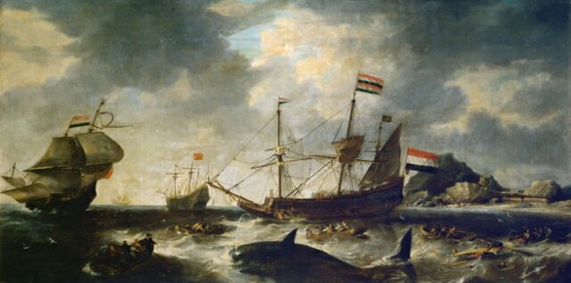
A Little Bit of History...
Over the past few hundred years, whales have been hunted and killed by humans for their meat, oil and bone.
Hmmm... are you curious?
Whalers were among the first Europeans to arrive in Aotearoa New Zealand in the 1820s and 1830s. But by 1956 whales were practically gone from the Southern Ocean and in 1964, the whaling trade in New Zealand died out.
Some scientists estimate that there has been a 60-90% reduction in overall whale numbers because of the whaling trade, with tens of millions of whales being killed.
What was the whale meat, oil and bone used for? Go and find out after this and report back.
This is an oil painting from 1645 by Dutch artist Bonaventura Peeters showing whales being hunted.

Slide 4
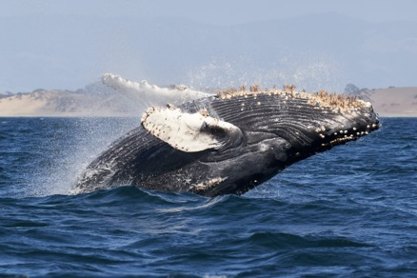
A Little Bit of History Continued...
It’s possible we wouldn’t have whales in the oceans at all right now if it weren’t for the International Whaling Commission (founded in 1949) and an organisation started in the 1970s called Save the Whales. As a result of their efforts, many countries signed up for a ban on commercial whaling in 1982.
Time for a whale break! Your teacher will play you some video footage of whales in action. Watch and listen.
There’s no denying that whales are beautiful, majestic and mesmerising creatures. Recent science has also shown that their vital part in the ocean ecosystem (particularly when they poo) could actually help save the world!
Ok, thinking about whale poo is a bit gross, isn’t it? But you still might be wondering... how could whale poo really help save the world? A great question to ask!
Let’s find out!!

Slide 5
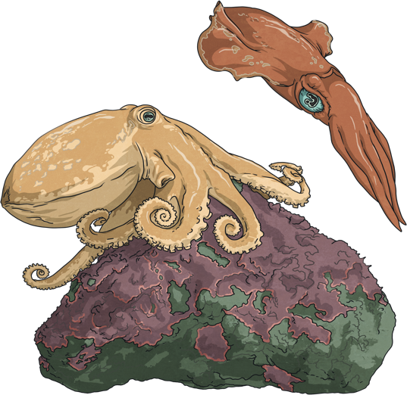
Eat, Poo, Repeat.
Sperm whales have been described as ecosystem engineers because they help support the balance and stability of the oceans. Most other large whales are baleen whales and therefore don't eat octopus and squid. Not only does this benefit the ocean and its creatures, but it also helps promote healthy fisheries that humans can take advantage of.
When sperm whales want to feed, they dive down to the depths of the ocean. As they descend, their bodies shut down all non-essential functions to conserve oxygen - that includes pooing.
Down in the deep, they feast on their favourite foods, octopus and squid. Whales can weigh up to 35 000kg, so they need to eat a lot of food, about 200 tons per year. Octopus and squid are full of the nutrient iron, which they store in their dark ink.
Remember this! It’s going to be important later.
You know what it’s like, don’t you? After you’ve eaten a big meal, you probably need to go to the bathroom and...
Enough said. You’ve got the picture.
When they’ve eaten enough food, the whales travel back to the surface. That’s when they release these enormous faecal plumes, which is a scientific way of saying they do a BIG POO!

Slide 6
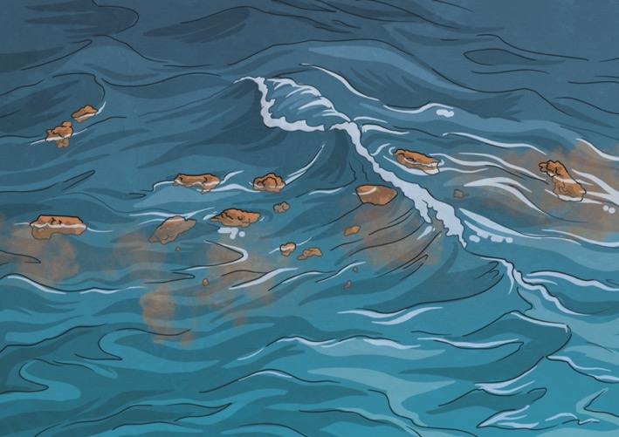
Eat, Poo, Repeat.
Whale poo is very loose and runny, with a few ‘chunky’ bits in it sometimes. Because of its consistency, it floats around at the top of the water instead of sinking.
This floating faeces is packed full of iron. The whales don’t need all the iron they’ve consumed for themselves, so they poo out about 90% of it.
Think back - where did this iron come from?
You remembered! From all the octopus and squid the sperm whale ate.
Don’t stop now! This is where things get really fascinating!

Slide 7
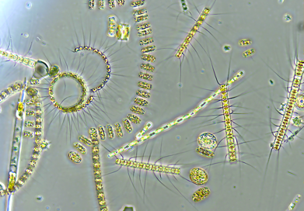
A Little Bit of History Continued...
What are phytoplankton?
Any ideas? Have a quick chat with a buddy.
Whale poo brings essential nutrients (including iron) from the ocean's depths to the surface, which in turn stimulates the growth of phytoplankton.
Derived from the Greek words phyto (plant) and plankton (made to wander or drift), phytoplankton are microscopic organisms that live in watery environments. They are the base of all marine food chains and they love iron. Phytoplankton don’t care where the iron comes from, even if it’s in the form of whale poo!
When there’s lots of iron available, it creates the perfect growing conditions for phytoplankton, and they begin to reproduce at a much greater rate. Scientists have observed that phytoplankton can double their numbers in a single day and create huge turquoise swirls in the water, called blooms. These drift near the surface of the ocean and are often visible from space. Check out the satellite image on the next slide.

Slide 8
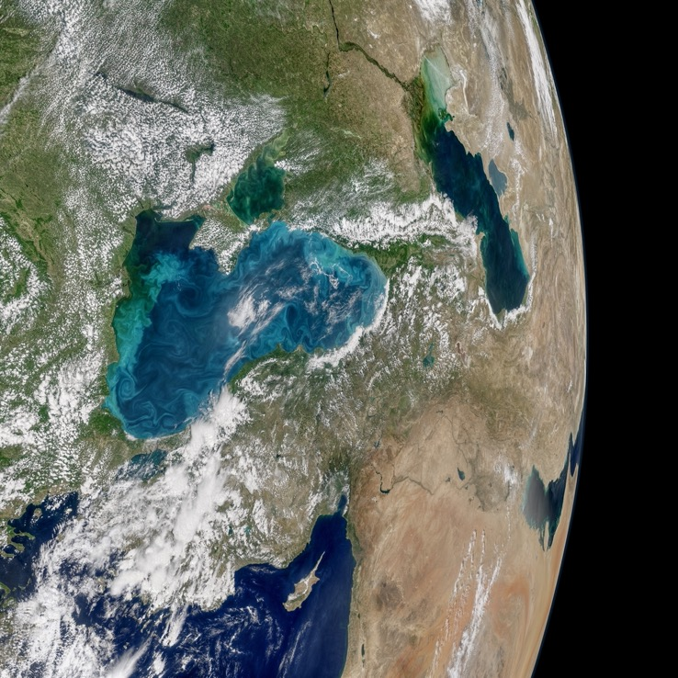
Phytoplankton and Poo
You can see the turquoise blooms of phytoplankton floating on the water.

Slide 9
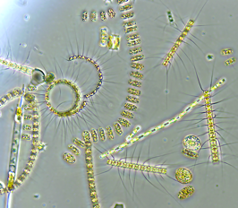
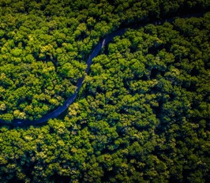
Phytoplankton and Poo
Iron is an essential nutrient required for photosynthesis. When there are large phytoplankton blooms, they begin to photosynthesize, converting tons of sugar out of carbon dioxide (CO₂) and water. In the process, they absorb lots of dissolved CO₂, which has ended up in the ocean from the air.
If the phytoplankton don’t get eaten by other sea animals, they eventually die and sink to the bottom of the ocean, taking the carbon part of CO₂ with them. These carbon deposits can remain there for a really long time - thousands of years. The deep oceans become a vast carbon sink that traps and stores this excess carbon.
Phytoplankton capture an estimated 40% of all the CO₂ produced, four times the amount captured by the Amazon rainforest.

Slide 10
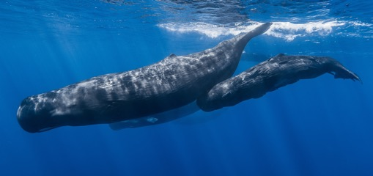
But That's Not All...
Whales undertake some of the longest migrations of all mammals. They travel each year to different parts of the ocean to feed, breed, give birth to and nurse their young calves.
Humpback whales, for instance, undertake migrations of approximately 10 000km every year between feeding grounds in Antarctica and breeding areas in more tropical waters. New Zealand is about 1600km long from North to South, so humpback whales travel almost six and a half times this distance and back! Wow!
As whales migrate, they carry and excrete ocean fertiliser in the form of their iron-rich runny poo from places in the ocean that have a good nutrient supply to places that need it (like Antarctica). They’re like giant ocean crop dusters!
Whales are vitally important for nutrient recycling in the ocean, both vertically (from the depths to the surface) and horizontally (migration).

Slide 11
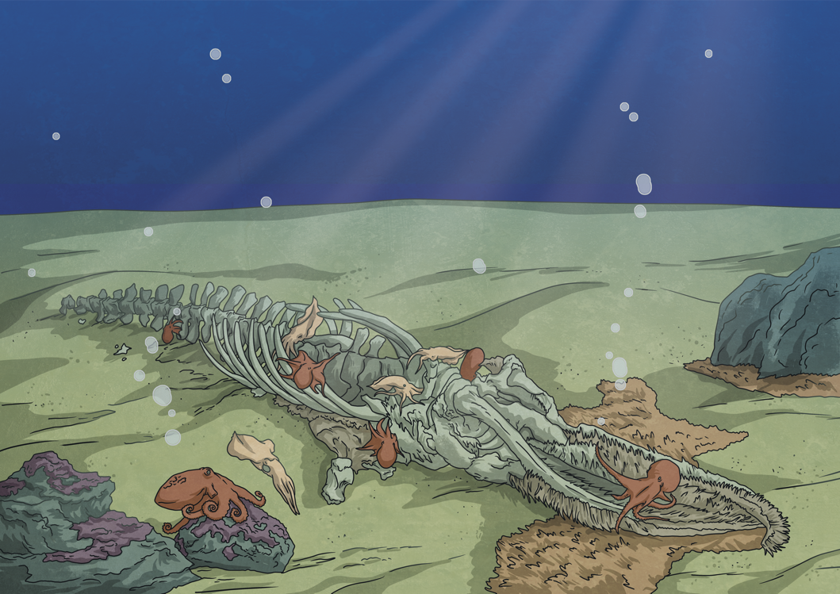
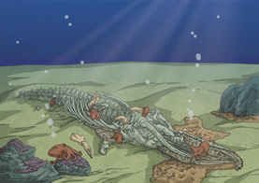
And There's More...
When whales die, it’s called whale fall. As their carcasses sink, not only do they provide meals for up to 400 other species, but they carry huge amounts of carbon which descends to the seabed with them. This carbon is also trapped and held in the carbon sink.
It’s estimated that whale carcasses transport around 190 000 tons of carbon to the deep ocean when they die, which is the same amount of carbon produced by 80 000 vehicles each year.
When whaling was at its peak, so many whale carcasses were removed from the ocean that it likely changed the weight and distribution of whale falls. As a result this probably led to the extinction of a number of species that were reliant on whale carcasses for survival.

Slide 12
HANG ON A MINUTE! STOP!
Global warming and climate change are huge issues in the world today, right?
What is global warming? Have a quick discussion with a buddy.
The earth is heating up because we are putting too much CO₂ into the atmosphere from things like fossil fuels.
Whales spread their iron-rich poo around the ocean as they migrate.
Phytoplankton love to feed on this iron-rich poo and, as a result, reproduce in huge numbers.
As these large blooms of phytoplankton photosynthesize, they capture large amounts of CO₂.
In whale fall, whale carcasses carry a huge amount of carbon with them which is trapped and held in the carbon sink on the ocean floor.
So if we want to reduce global warming and make a difference with the climate change issue...
Can you make the logical connections and next steps to figure out just how whale poo could help save the world?

Slide 13
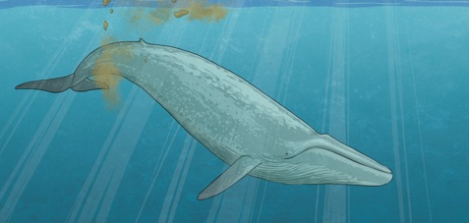
HANG ON A MINUTE! STOP!
So if we want to reduce global warming and make a difference with the climate change issue...
Was your thinking something along these lines?
Protect whales and their ocean habitats so they can feed and breed which will increase their numbers. (The ocean is not going to run out of room!)
There’ll be more whale poo.
There’ll be more whale fall.
The ocean will be a more balanced, stable and healthy ecosystem.
There’ll be more phytoplankton.
More photosynthesis will occur.
More CO₂ will be captured in the carbon sink, removing it from the atmosphere.
All of which will help buffer us from the effects of global warming and climate change.
Therefore... = WHALE POO COULD HELP SAVE THE WORLD!!

Slide 14
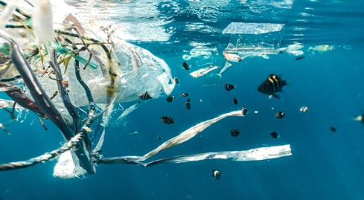
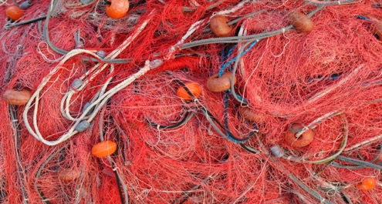
But... Whales Are Still Threatened
What do you think are the biggest threats to whales today? Have a discussion and then see if your ideas line up with these:
Plastic Pollution
Fishing Net Entanglement
Plastic gets into the ocean food chain when creatures (including whales) eat it, thinking it’s their prey. They’re not able to digest plastic, and it’s harmful to their health.
It’s easy for whales to become entangled in commercial fishing nets that may have been abandoned. This can affect their ability to swim freely.

Slide 15
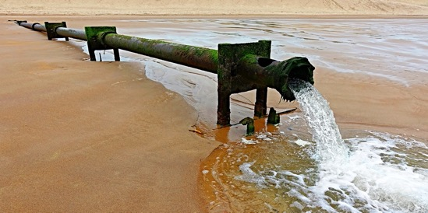
But... Whales Are Still Threatened
What do you think are the biggest threats to whales today? Have a discussion and then see if your ideas line up with these:
Global Warming
Toxic Chemicals
Higher temperatures on land, caused by too much CO₂ in the atmosphere, also causes ocean temperatures to rise.
When these get into the ocean ecosystem because of human activity, they can damage the whale’s reproductive and immune system.

Slide 16
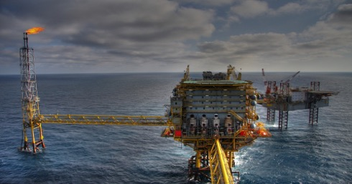
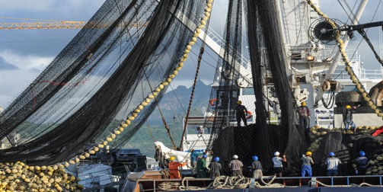
But... Whales Are Still Threatened
What do you think are the biggest threats to whales today? Have a discussion and then see if your ideas line up with these:
Oil and Gas Developments
Whaling
Companies looking for oil and gas deep in the ocean can affect the breeding and feeding areas of whales. The habitat of whales gets smaller and more degraded.
Even though most countries have signed up to a worldwide ban on commercial whaling, both Norway and Japan still continue to hunt and kill whales.

Slide 17
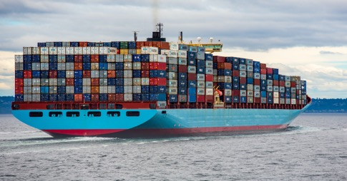
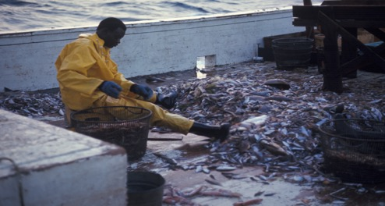
But... Whales Are Still Threatened
What do you think are the biggest threats to whales today? Have a discussion and then see if your ideas line up with these:
Ship Strike
Bycatch
Huge container ships can easily plough down whales as they travel across the ocean.
Unwanted fish and other marine creatures get trapped by commercial fishing nets as they’re fishing for a different species. This bycatch put the food supply of whales and all marine mammals at risk.

Slide 18
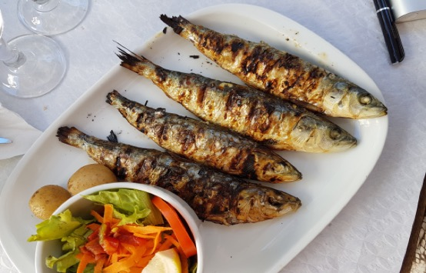
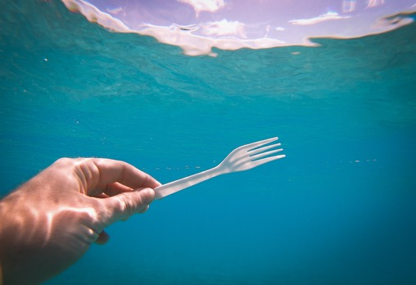
How Could We Help?
Any ideas? Have a discussion and then see if your ideas line up with these:
Smart Seafood Choices
Say ‘No’ to Single Use Plastics
Choose not to eat seafood or only to eat species that are plentiful in the ocean.
This will help keep these plastics from ending up in the oceans.

Slide 19
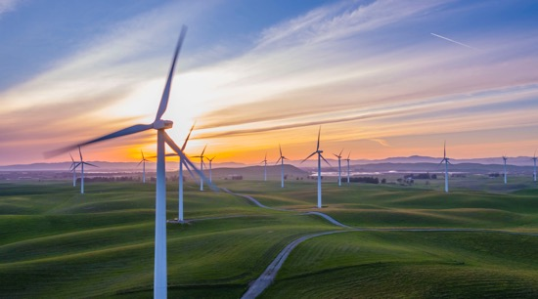
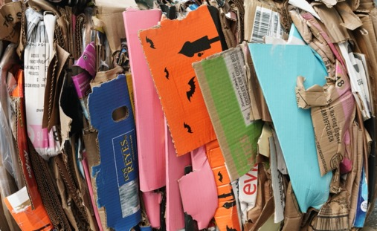
How Could We Help?
Any ideas? Have a discussion and then see if your ideas line up with these:
Reduce Your Carbon Footprint
Reduce Reuse Recycle
Choose renewable energy sources. Buy energy efficient appliances and vehicles. Use less water.
Reduce your waste in whatever way you can.

Slide 20
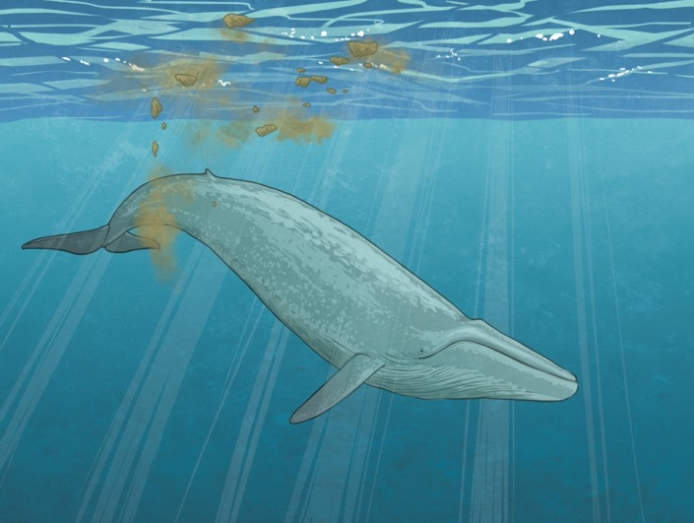
Whale Poo Could Help Save the World!
Some final questions for you to discuss:
What has blown your mind a little bit?
What’s the most interesting thing you’ve learnt that you didn’t know before?
What will you tell your family about at the dinner table tonight?
How does knowing all this change your perspective on whales? On global warming and climate change?
Is there something you want to know more about as a result of learning about whale poo?

